Slide 1

CHAPTER 8
Cellular Membrane
Notes:
On March 20, 1995, during the morning rush hour in the Tokyo Subway system, one of the busiest in the world, a religious cult released a chemical called Sarin into the air. The attack was coordinated between multiple subway stations, and before long thousands of people were finding it difficult to breathe. Although only eight people died in the attack, hundreds were seriously injured. Sarin is a type of nerve gas—a chemical weapon produced by the Nazis that is designed to interfere with the nervous system. After world war II, both the United States and the Soviet Union produced massive stockpiles of sarin and other nerve gases, and while these weapons were not used on a global scale, nerve gas was used by Iraqi armed forces in an attack on the Kurdish city of Halabja in 1988, as well as in the Iran–Iraq war. The sarin molecule is small but deadly, and it works by poisoning an enzyme that degrades chemical signals used by nerves to activate muscle cells. Sarin victims die because the muscles used for breathing become paralyzed. In this chapter we will learn how proteins in the cell membrane convert chemical signals to electrical signals that are required for many physiological activities.

Slide 2
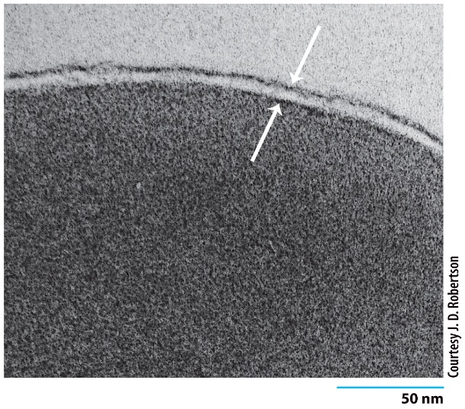
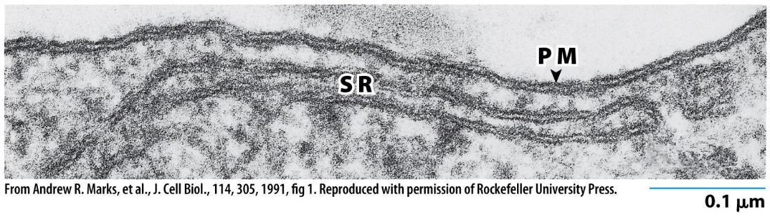
8.1 | Introduction to the Plasma Membrane
The trilaminar appearance of membranes as revealed by electron micrograph of the plasma membrane and sarcoplasmic reticulum.
Plasma membrane: The outer boundary of the cell that separates it from the world is a thin, fragile structure about 5 – 10 nm thick.
Not detectable with light microscope need electron microscope.
The 2 dark-staining layers in the electron micrographs correspond primarily to the inner & outer polar surfaces of the bilayer.
All membranes examined closely (plasma, nuclear or cytoplasmic) from plants, animals or microorganisms have the same ultrastructure.
Notes:
Figure 8.1a, b
The trilaminar appearance of membranes. (A) Electron micrograph showing the three-layered (trilaminar) structure of the plasma membrane of an erythrocyte after staining the tissue with the heavy metal osmium. Osmium binds preferentially to the polar head groups of the lipid bilayer, producing the trilaminar pattern. The arrows denote the inner and outer edges of the membrane. (B) The outer edge of a differentiated muscle cell grown in culture showing the similar trilaminar structure of both the plasma membrane (PM) and the membrane of the sarcoplasmic reticulum (SR), a calcium-storing compartment of the cytoplasm.

Slide 3
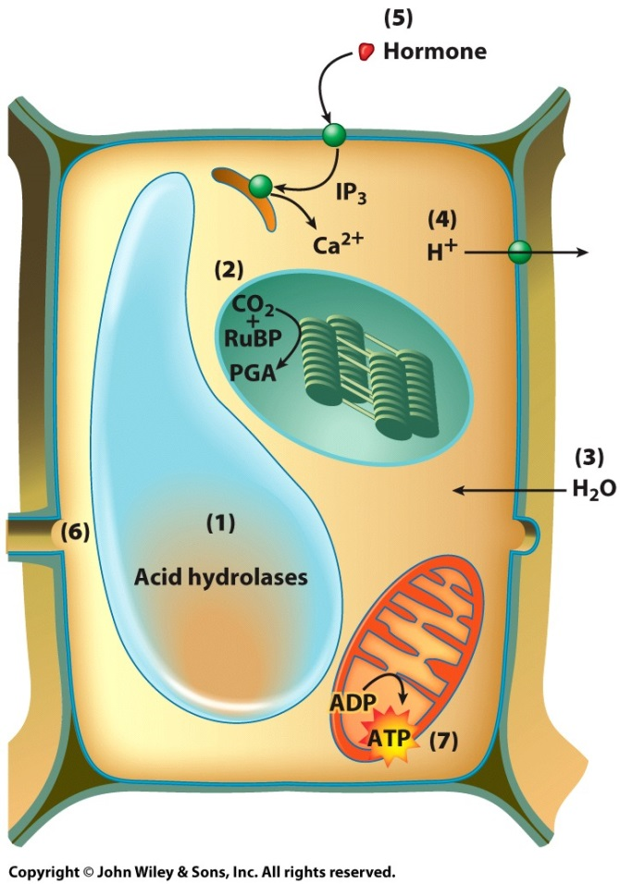
8.1 | Introduction to the Plasma Membrane
An Overview of Membrane Functions
Compartmentalization: Membranes form continuous sheets that enclose intracellular compartments.
Scaffold for biochemical activities: Membranes provide a framework that organizes enzymes for effective interaction.
Selectively permeable barrier: Membranes allow regulated exchange of substances between compartments.
A summary of membrane functions in a plant cell.
Notes:
Figure 8.2
A summary of membrane functions in a plant cell. (1) An example of membrane compartmentalization in which hydrolytic enzymes (acid hydrolases) are sequestered within the membrane-bounded vacuole. (2) An example of the role of cytoplasmic membranes as a site of enzyme localization. The fixation of CO2 by the plant cell is catalyzed by an enzyme that is associated with the outer surface of the thylakoid membranes of the chloroplasts. (3) An example of the role of membranes as a selectively permeable barrier. Water molecules are able to penetrate rapidly through the plasma membrane, causing the plant cell to fill out the available space and exert pressure against its cell wall. (4) An example of solute transport. Hydrogen ions, which are produced by various metabolic processes in the cytoplasm, are pumped out of plant cells into the extracellular space by a transport protein located in the plasma membrane. (5) An example of the involvement of a membrane in the transfer of information from one side to another (signal transduction). In this case, a hormone (e.g., abscisic acid) binds to the outer surface of the plasma membrane and triggers the release of a chemical message (such as IP3) into the cytoplasm. In this case, IP3 causes release of Ca2 ions from a cytoplasmic warehouse. (6) An example of the role of membranes in cell–cell communication. Openings between adjoining plant cells, called plasmodesmata, allow materials to move directly from the cytoplasm of one cell into its neighbors. (7) An example of the role of membranes in energy transduction. The conversion of ADP to ATP occurs in close association with the inner membrane of the mitochondrion.
Scaffold : 발판
Compartmentalization
구획화
Ex. Hydrolytic enzyme 같은 건 구획화 되어 있어야지. → 리소좀 세포막이 이 역할 해주지
2. Scaffold for biochemical activities
A → B → C 가 각각 cytoplasm 에 각각 떨어져 있는 상태에서 신호 전달하는 경우보다
Scaffold protein 에 A, B, C가 붙은 상테에서 신호 전달할 때 훨씬 더 잘 전달된다. -> membrane이 scaffold 역할을 할 수 있다.
Ex) 미토콘드리아 inner membrane 도 전자 전달계에서 관련된 protein이 membrane과 interaction해서 전자전달계 기능이 더 수월하게 이뤄짐.
Ex2) 식물세포의 CO2 고정은 엽록체 틸라코이드 막에 있는 enzyme 들에 의해 촉진된다.
Scaffold protein: 생물학에서 스캐폴드 단백질은 신호 전달에서 매우 중요한 조절자로서의 역할을 지닌다. 스캐폴드 단백질의 정확한 기능과 성질은 밝혀져 있지 않지만 기초물질의 단백질로서, 그들은 신호 전달 물질들을 단백질 복합체로 합성하면서 신호 전달 과정에서 많은 상호 작용을 하는 것으로 알려져있다. 이러한 신호 전달 과정에서 스캐폴드 단백질은 신호 형질 도입을 조절하고, 원형질막, 세포질, 세포 핵, 골지체,엔도솜, 그리고 미토콘드리아와 같은 세포 내 특정 위치로 (복합체로 구성된) 신호 전달 물질들을 전달하는 과정에 큰 역할을 한다.
3. Selectively permeable barrier
장벽의 역할 + 선택적 투과성

Slide 4
8.1 | Introduction to the Plasma Membrane
An Overview of Membrane Functions
Transporting solutes: Membrane proteins facilitate the movement of substances between compartments.
Responding to external signals: Membrane receptors transduce signals from outside the cell in response to specific ligands.
Intercellular interaction: Membranes mediate recognition and interaction between adjacent cells.
Energy transduction: Membranes transduce photosynthetic energy, convert chemical energy to ATP, and store energy.
A summary of membrane functions in a plant cell.
Notes:
Figure 8.2
A summary of membrane functions in a plant cell. (1) An example of membrane compartmentalization in which hydrolytic enzymes (acid hydrolases) are sequestered within the membrane-bounded vacuole. (2) An example of the role of cytoplasmic membranes as a site of enzyme localization. The fixation of CO2 by the plant cell is catalyzed by an enzyme that is associated with the outer surface of the thylakoid membranes of the chloroplasts. (3) An example of the role of membranes as a selectively permeable barrier. Water molecules are able to penetrate rapidly through the plasma membrane, causing the plant cell to fill out the available space and exert pressure against its cell wall. (4) An example of solute transport. Hydrogen ions, which are produced by various metabolic processes in the cytoplasm, are pumped out of plant cells into the extracellular space by a transport protein located in the plasma membrane. (5) An example of the involvement of a membrane in the transfer of information from one side to another (signal transduction). In this case, a hormone (e.g., abscisic acid) binds to the outer surface of the plasma membrane and triggers the release of a chemical message (such as IP3) into the cytoplasm. In this case, IP3 causes release of Ca2 ions from a cytoplasmic warehouse. (6) An example of the role of membranes in cell–cell communication. Openings between adjoining plant cells, called plasmodesmata( = 원형질연락사 ), allow materials to move directly from the cytoplasm of one cell into its neighbors. (7) An example of the role of membranes in energy transduction. The conversion of ADP to ATP occurs in close association with the inner membrane of the mitochondrion.
4. Transporting solutes
수송 단백질 有
5. Responding to external signals
Steroid hormone 은 plasma membrane 통과 가능 but 나머지 hormone 은 통과 x -> hormone은 target cell 에 작용해서 hormone 이 가지고 있는 정보를 cell에 전달해야 해
그래서 세포와 어떤 반응은 일어나겠지. -> Membrane receptors이 hormone 과 반응해서 signal을 변형시켜 내부로 전달
6. Intercellular interaction
인접 cell과 인식/ 상호작용
Ex. Epithelial cell (상피세포) : 얘넨 방향성이 있다.
7. Energy transduction
에너지 변환
Ex. 광합성 에너지 → 화학 에너지 (ATP)

Slide 5
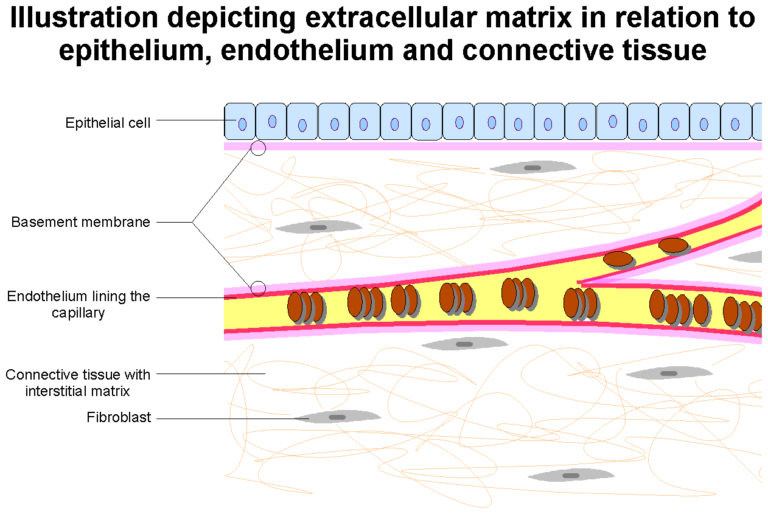
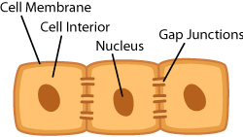
Notes:
*내가 따로 추가
위 세포들은 Epithelial cell (상피세포)
=> 상피세포는 Top Bottom Side 쪽 membrane 에 존재하는 protein이 다 달라.
1. Bottom
- 상피세포가 바닥 쪽에 결합하고 있는 protein layer를 basement membrane 이라고 한다. (ECM : extracellular matrix)
2. Side
Gap junctions 가 있어 분자량 작은 분자들은 세포 간 이동 가능.
특정 상피세포에 신호가 가든 해서 어떤 물질이 많이 생성되었다. → 인접세포로 이동
Ex. Cyclic AMP, calcium ion 같은 분자 이동 가능

Slide 6
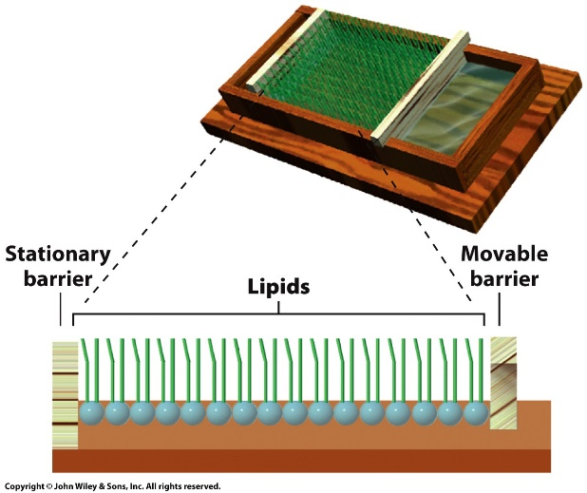
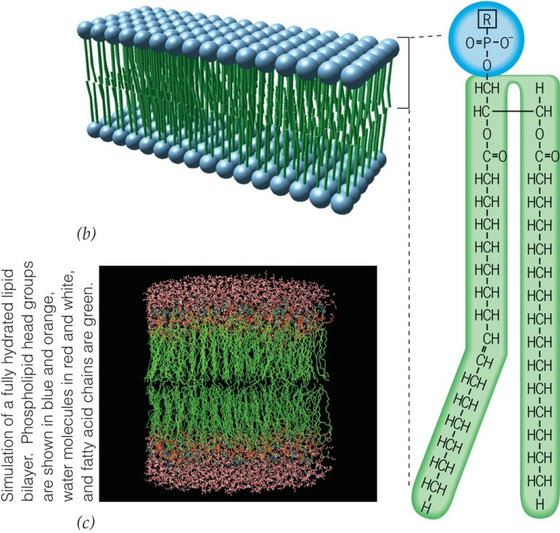
8.1 | Introduction to the Plasma Membrane
A Brief History of Studies on Plasma Membrane Structure
Calculating the surface area of a lipid preparation
Membranes were found to be mostly composed of lipids because their dissolving power matched that of oil.
The lipid bilayer accounted for the 2:1 ratio of lipid to cell surface area.
The most energetically favored orientation for polar head groups is facing the aqueous compartments outside of the bilayer.
Bimolecular layer of phospholipids with water soluble head groups facing outward
Notes:
Figure 8.3a-c
The plasma membrane contains a lipid bilayer. (A) Calculating the surface area of a lipid preparation. When a sample of phospholipids is dissolved in an organic solvent, such as hexane, and spread over an aqueous surface, the phospholipid molecules form a layer over the water that is a single molecule thick: a monomolecular layer. The molecules in the layer are oriented with their hydrophilic groups bonded to the surface of the water and their hydrophobic chains directed into the air. To estimate the surface area the lipids would cover if they were part of a membrane, the lipid molecules can be compressed into the smallest possible area by means of movable barriers. Using this type of apparatus, which is called a Langmuir trough after its inventor, Gorter and Grendel concluded that red blood cells contained enough lipid to form a layer over their surface that was two molecules thick: a bilayer. (B) As Gorter and Grendel first proposed, the core of a membrane contains a bimolecular layer of phospholipids oriented with their water soluble head groups facing the outer surfaces and their hydrophobic fatty acid tails facing the interior. The structures of the head groups are given in Figure 8.6a. (C) Simulation of a fully hydrated lipid bilayer composed of the phospholipid phosphatidylcholine. Phospholipid head groups are orange, water molecules are blue and white, fatty acid chains are green.
Glycerol (1번 carbon) + fatty acid
Glycerol (2번 carbon) + fatty acid
Glycerol (3번 carbon) + phosphate group + (Hydrophilic 한 size 크지 않은 구조) ex. Choline , Serine
이 결합을 각각 ester linkage 라고 함. ( H2O 나오고 ) -> 3번 carbon 이랑 phosphate 랑 결합하는 것도 ester linkage
➔ Hydrophilic part + Hydrophobic part 有 → Lipid bilayer 형성

Slide 7
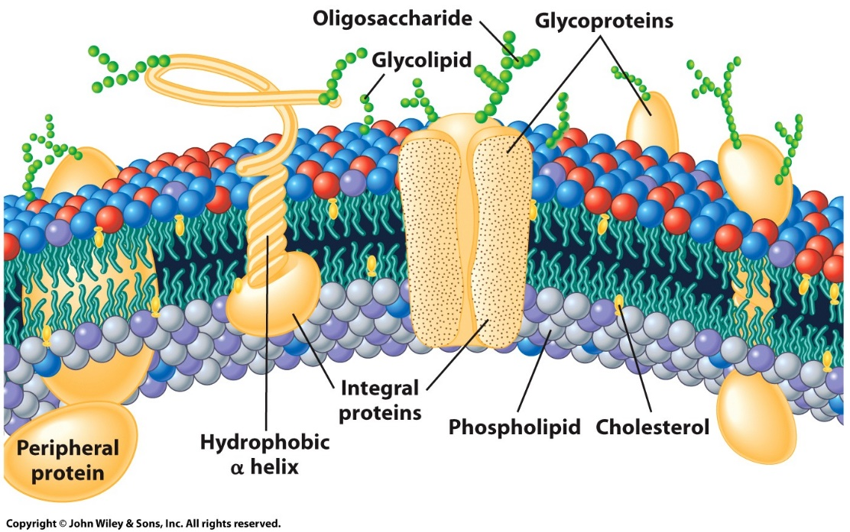
8.1 | Introduction to the Plasma Membrane
A Brief History of Studies on Plasma Membrane Structure
Cell physiologists determined that there must be more to the structure of membranes than simply a lipid bilayer.
Lipid solubility was not the sole determining factor as to whether a substance could penetrate the plasma membrane.
Surface tensions of membranes were calculated to be much lower than those of pure lipid structures; explained by the presence of protein in the membrane.
Organization of proteins embedded in the lipid bilayer
Notes:
Figure 8.4 a, b
Plasma membranes as lipid plus proteins. (a) A representation of the plasma membrane showing the organization of proteins embedded in the lipid bilayer. The external surface of most membrane proteins, as well as a small percentage of the phospholipids, contain short chains of sugars, making them glycoproteins and glycolipids. Those portions of the polypeptide chains that extend through the lipid bilayer typically occur as a helices composed of hydrophobic amino acids. The two leaflets of the bilayer contain different types of lipids as indicated by the differently colored head groups. (b) Molecular model of the membrane of a synaptic vesicle (시냅스 소포의 막) constructed using known structures of the various proteins along with information on their relative numbers obtained from the analysis of purified synaptic vesicles. The high protein density of the membrane is apparent. Most of the proteins in this membrane are required for the interaction of the vesicle with the plasma membrane. The large blue protein at the lower right pumps H+ ions into the vesicle.
Membrane에 묻혀 있는 protein은 amino acid가 a-helix 구조를 이루고 있음 -> 대략 aa 20개 정도가 bilayer 두께랑 맞아 떨어짐.
if. 어떤 protein의 aa 의 side chain(R) 이 hydrophobic한 것들로 연속적으로 20여개 나열된 것이면 → cell membrane 에 존재하는 protein 이구나 라고 추측 가능.
Membrane 과 interaction 하는 protein
-> integral protein
-> peripheral protein
Glycoprotein 에서 당 구조는 세포 바깥쪽으로만 노출되어 있음
추측: glycoprotein 에서 당 구조가 없으면 기능 못하는 경우가 많음 → 즉 매우 중요한 역할을 함 → 세포 밖 여러 물질과 상호작용
Glycosylation (당화)
단백질 번역 후 과정임. 골지체에서 일어나며 단백질에 lactose || fucose 같은 당이 붙는 과정을 통틀어 지칭하는 말
O-glycosylation : 당 물질을 단백질의 O 원자에 붙는 것 ( serine (Ser) or threonine (Thr) residues in a protein )
– CH2-’O’H -C-’O’H
|
CH3
2. N-glycosylation : 당 물질을 단백질의 N 원자에 붙는 것 ( 아스파라긴 (Asn) 의 R기는 –CH2-C=O → 저 c=0 nh2 → amide group의 N과 당 물질 결합)
| ‘N’H2

Slide 8
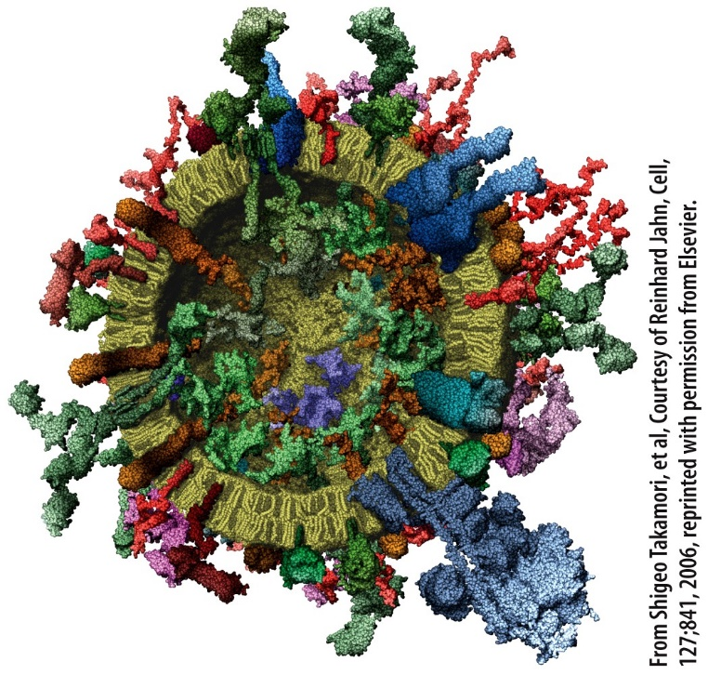
8.1 | Introduction to the Plasma Membrane
A Brief History of Studies on Plasma Membrane Structure
Protein is present in the form of individual protein molecules and protein complexes that penetrate a fluid lipid bilayer and extend out into the surrounding aqueous environment.
Due to lipid bilayer fluidity, membranes are dynamic structures in which the components are mobile and capable of coming together for transient interactions.
Molecular model of the membrane of a synaptic vesicle constructed with various proteins embedded into the lipid bilayer
Notes:
Figure 8.4 a, b
Plasma membranes as lipid plus proteins. (a) A representation of the plasma membrane showing the organization of proteins embedded in the lipid bilayer. The external surface of most membrane proteins, as well as a small percentage of the phospholipids, contain short chains of sugars, making them glycoproteins and glycolipids. Those portions of the polypeptide chains that extend through the lipid bilayer typically occur as a helices composed of hydrophobic amino acids. The two leaflets of the bilayer contain different types of lipids as indicated by the differently colored head groups. (b) Molecular model of the membrane of a synaptic vesicle constructed using known structures of the various proteins along with information on their relative numbers obtained from the analysis of purified synaptic vesicles. The high protein density of the membrane is apparent. Most of the proteins in this membrane are required for the interaction of the vesicle with the plasma membrane. The large blue protein at the lower right pumps H+ ions into the vesicle.

Slide 9
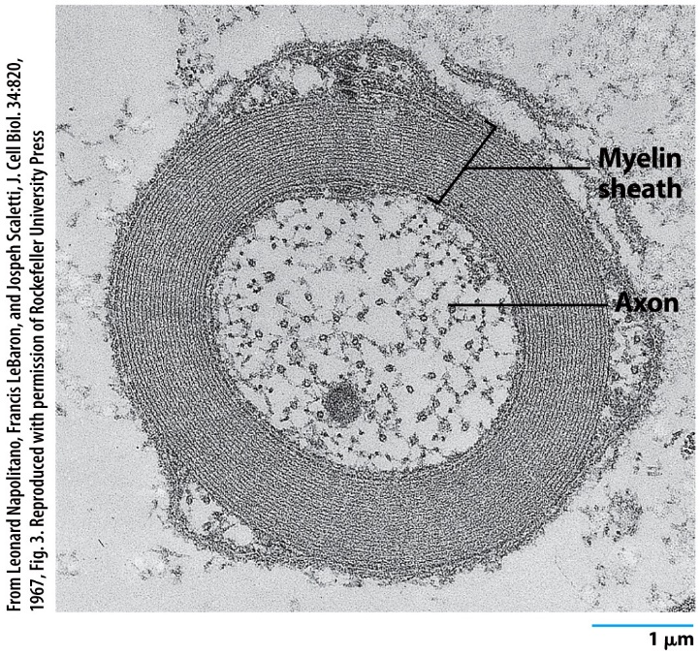
8.2 | The Lipid Composition of Membranes
Membranes are lipid–protein assemblies held together by noncovalent bonds.
The lipid bilayer is a structural backbone and barrier to prevent random movements of materials into and out of the cell.
A unique complement of membrane proteins that contributes to the specialized activities of that cell type.
The ratio of lipid to protein varies, depending on the type of cellular membrane, the type of organism, and the type of cell.
Electron micrograph of a nerve cell axon
Notes:
Figure 8.5
The myelin sheath. Electron micrograph of a nerve cell axon surrounded by a myelin sheath consisting of concentric layers of plasma membrane that have an extremely low protein/lipid ratio. The myelin sheath insulates the nerve cell from the surrounding environment, which increases the velocity at which impulses can travel along the axon. The perfect spacing between the layers is maintained by interlocking protein molecules (called P₀) that project from each membrane.
Lipid 와 protein 의 상대적인 양 → 어떤 membrane 인지에 따라 다름
Plasma membrane 의 특징적인 기능에 따라 다르지. 뒷장

Slide 10
8.2 | The Lipid Composition of Membranes
Membrane Lipids
Membrane lipids are amphipathic with three main types:
Phosphoglycerides are diacylglycerides with small functional head groups linked to the glycerol backbone by phosphate ester bonds.
Sphingolipids are ceramides formed by the attachment of sphingosine to fatty acids.
Cholesterol is a smaller and less amphipathic lipid that is only found in animals.
Notes:
이들도 다 amphipathic 한 성질을 가지고 있음
Sphingolipid = sphingosine (18-carbon amino alcohol with an unsaturated hydrocarbon chain,) + FA
이 중 cholesterol 은 동물의 membrane 에서만 발견된다. (4개의 ring 구조로 이뤄짐) → 측면에서 보면 평평한 flat한 판 모양임.
Cholesterol이 많이 존재할수록 Membrane의 fluidity 가 떨어짐. (움직이는데 걸리적)

Slide 11
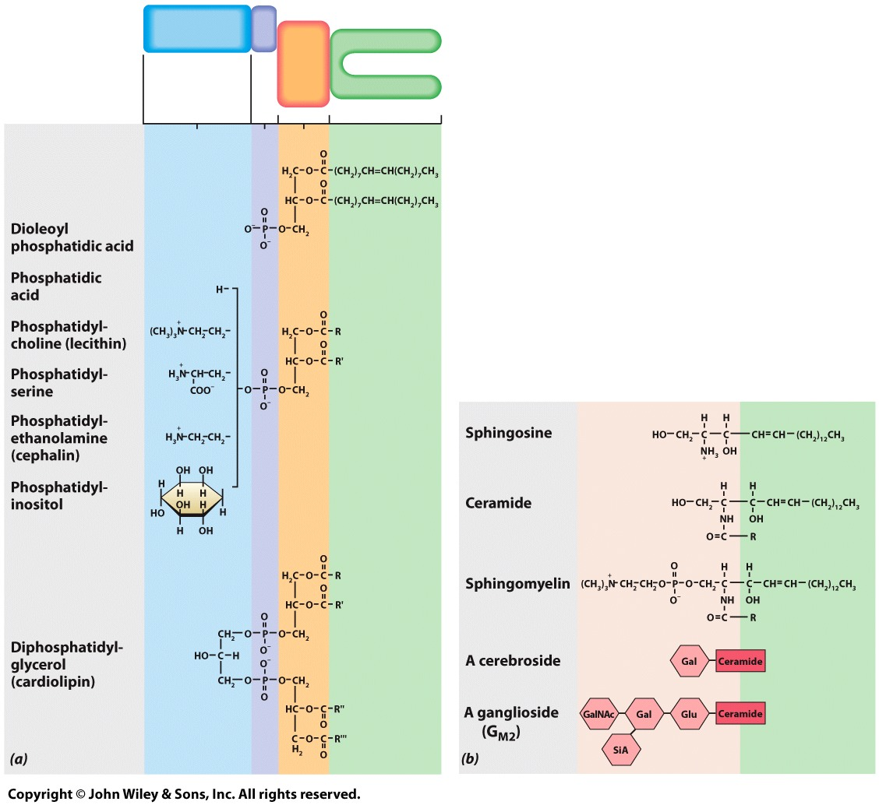
8.2 | The Lipid Composition of Membranes
Membrane Lipids: Phosphoglycerides
Polar
P
Glycerol
Lipids with a phosphate group are phospholipids. Phospholipids built on a glycerol backbone are called phosphoglycerides.
Membrane glycerides are diglycerides; two hydroxyl groups of glycerol are esterified to fatty acids; the third is esterified to a hydrophilic phosphate group.
Most phosphoglycerides have a small hydrophilic group linked to phosphate: choline, ethanolamine, serine or inositol.
This group, together with the negatively charged phosphate, forms a highly water-soluble domain, called the head group.
Fatty acid
chain
Notes:
Figure 8.6a, b
The chemical structure of membrane lipids. (A) The structures of phosphoglycerides. (B) The structures of sphingolipids. Sphingomyelin is a phospholipid; cerebrosides and gangliosides are glycolipids. A third membrane lipid is cholesterol. (R= fatty acyl chain).
Diglyceride : 2개 FA가 ester linkage 되어있는 글리세롤 화합물
3번 carbon –oh에 phosphate 결합
Phosphate와 hydrophilic 한 물질이 와서 결합. → 둘을 합쳐서 head group 이라고 함.
FA 가 saturated 되어있냐 unsaturated 되어있냐 || 만약 unsaturated form 이면 cis form 이냐 trans form 이냐
→ 꺾인 부분이 많으면 fluidity 는 증가하지.

Slide 12
8.2 | The Lipid Composition of Membranes
Membrane Lipids: Phosphoglycerides
Polar
P
Glycerol
Fatty acid
chain
Fatty acyl chains are hydrophobic, unbranched hydrocarbons approximately 16 to 22 carbons in length.
A fatty acid may be fully saturated, monounsaturated, or polyunsaturated.
Phosphoglycerides often contain one unsaturated and one saturated fatty acyl chain.
With fatty acid chains at one end of the molecule and a polar head group at the other end, all of the phosphoglycerides exhibit a distinct amphipathic character.
Notes:
Figure 8.6a, b
The chemical structure of membrane lipids. (A) The structures of phosphoglycerides. (B) The structures of sphingolipids. Sphingomyelin is a phospholipid; cerebrosides and gangliosides are glycolipids. A third membrane lipid is cholesterol. (R= fatty acyl chain).
Acyl group : O
||
C
R-| |-R

Slide 13
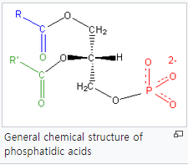
Notes:
The platform on which phospholipids are built may be glycerol, a 3- carbon alcohol, or sphingosine, a more complex alcohol. Phospholipids derived from glycerol are called phosphoglycerides. A phosphoglyceride consists of a glycerol backbone to which two fatty acid chains and a phosphorylated alcohol are attached.
<해석 / 요약>
→ Phospholipid는
glycerol / 3-carbon alocohol / sphingosine / more complex alcohol
로부터 만들어진다.
→ Phospholipid 중 glycerol에서 유래한 phospholipid를 ‘phosphoglyceride’ 라고 한다.

Slide 14
8.2 | The Lipid Composition of Membranes
Membrane Lipids: Sphingolipids
Sphingolipids are derivatives of sphingosine, an amino alcohol
that contains a long hydrocarbon chain.
Sphingolipids consist of sphingosine linked to a fatty acid by its amino group, called a ceramide.
If the substitution is phosphorylcholine, the molecule is sphingomyelin. If the substitution is a carbohydrate, the molecule is a glycolipid.
If the carbohydrate is a simple sugar, the glycolipid is a cerebroside; if it is a small cluster of sugars that includes sialic acid, the glycolipid is a ganglioside.
The chemical structure of membrane lipids
Notes:
Figure 8.6a, b
The chemical structure of membrane lipids. (A) The structures of phosphoglycerides. (B) The structures of sphingolipids. Sphingomyelin is a phospholipid; cerebrosides and gangliosides are glycolipids. A third membrane lipid is cholesterol. (R= fatty acyl chain).
Sialic acid = n-acetylneuraminic acid
Second, the ceramide base contains four hydroxyl groups that are available for hydrogen bond formation. The amide bond also contributes both proton donors and acceptors for hydrogen bonding. Because these constituents reside in a hydrophobic region, the hydrogen bonds that form are stronger than they would be in aqueous medium. These interlipid hydrogen bonds increase lateral cohesion, and therefore also decrease membrane fluidity.

Slide 15
8.2 | The Lipid Composition of Membranes
Membrane Lipids: Sphingolipids
The nervous system is rich in glycolipids; myelin sheaths contain a high content of galactocerebroside.
Mice lacking the enzyme that makes this glycolipid exhibit severe muscular tremors and eventual paralysis. Humans unable to synthesize ganglioside (GM3) suffer from a serious neurological disease characterized by severe seizures and blindness.
Glycolipids play a role in infectious diseases; toxins that cause cholera and botulism both enter their target cell by first binding to cell-surface gangliosides, as does the influenza virus.
The chemical structure of membrane lipids
Notes:
Figure 8.6a, b
The chemical structure of membrane lipids. (A) The structures of phosphoglycerides. (B) The structures of sphingolipids. Sphingomyelin is a phospholipid; cerebrosides and gangliosides are glycolipids. A third membrane lipid is cholesterol. (R= fatty acyl chain).

Slide 16
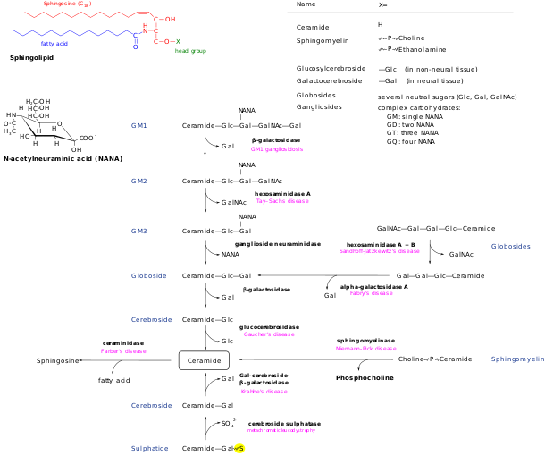


Notes:
이런 식으로 분해되는 과정에서 하나라도 잘못되면
질환이 생김

Slide 17
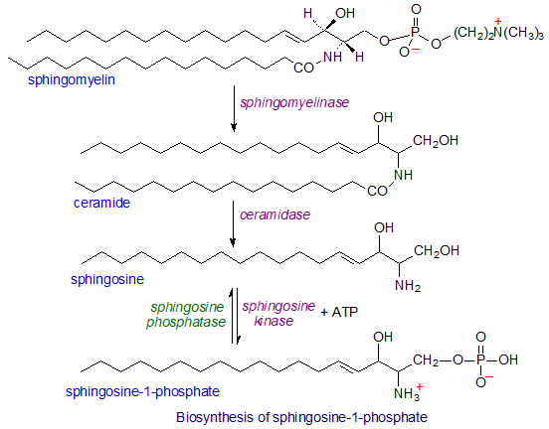
Notes:
Now it is recognized as a crucial element in both intra- and inter-cellular signalling, especially in animal cells, with innumerable biological effects; hundreds of publications appear every year on the topic. However, its functions cannot be described in isolation, and they must be considered together with those of the metabolically related sphingolipids ceramides, sphingoid bases and ceramide-1-phosphate, which have their own web pages here, as part of the sphingolipid rheostat. Catabolism of sphingosine-1-phosphate is ultimately the means by which all sphingolipids are removed from cells.
정리
intra- and inter-cellular signaling (특히 animal cell)
(혼자 저 기능을 하는 건 아니고 저 위에 3개 ceramides 등등과 같은 것들과 상호작용해서 기능. )
Sphingomyelin → ceramide → sphingosine → sphingosine-1-phosphate 과정을 통해 합성됨

Slide 18
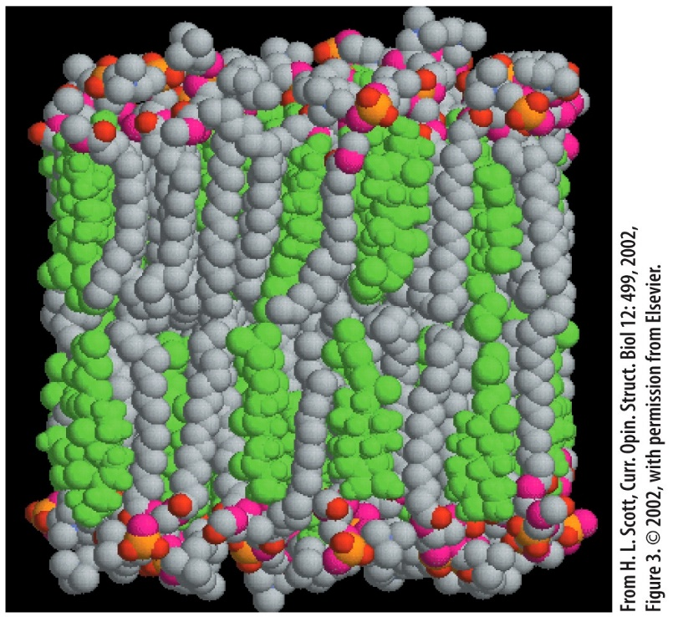
8.2 | The Lipid Composition of Membranes
Membrane Lipids: Cholesterol
Cholesterol is a smaller and less amphipathic lipid that is only found in animals.
A sterol that makes up to 50% of animal membrane lipids.
The -OH group is oriented toward membrane surface.
Carbon rings are flat and rigid; interfere with movement of phospholipid fatty acid tails
Cholesterol molecules (green) oriented with their small hydrophilic end facing the external surface of the bilayer
Notes:
Figure 8.7
The cholesterol molecules (shown in green) of a lipid bilayer are oriented with their small hydrophilic end facing the external surface of the bilayer and the bulk of their structure packed in among the fatty acid tails of the phospholipids. The placement of cholesterol molecules interferes with the flexibility of the lipid hydrocarbon chains, which tends to stiffen the bilayer while maintaining its overall fluidity. Unlike other lipids of the membrane, cholesterol is often rather evenly distributed between the two layers (leaflets).
Fluidity 떨어뜨림~~

Slide 19
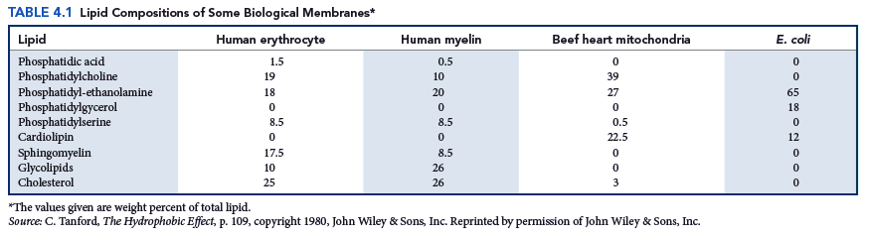
8.2 | The Lipid Composition of Membranes
The Nature and Importance of the Lipid Bilayer
Cells membranes have distinct lipid compositions, differing in lipid types, head groups, and species of fatty acyl chain(s).
Membranes contain hundreds of chemically distinct species of phospholipids.
Lipid composition can determine the physical state of the membrane and influence membrane protein activity. Membrane lipids can be precursors for highly active chemical messengers that regulate cellular function.
Notes:
Myelin : 신경세포의 axon 부위를 감싸고 있는 것
Lipid composition 이 다름
Lipid type ( sphingomyelin phosphatidylcholine phosphatidylserine cholesterol ….. )
Head groups ( cholin 등등 여러 종류 있음)
Fatty acyl chain 의 종류 (포화인지 불포화인지 cis 인지 trans 인지)

Slide 20
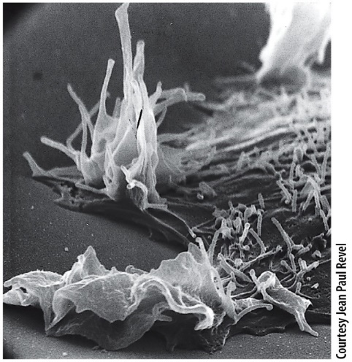
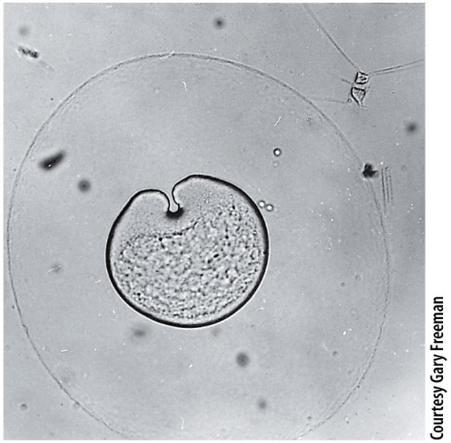
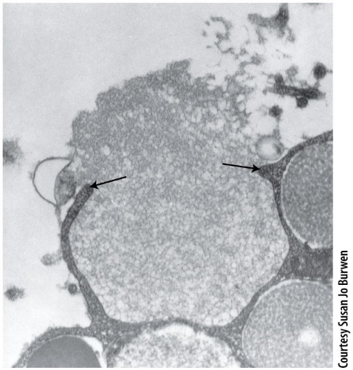
8.2 | The Lipid Composition of Membranes
The Nature and Importance of the Lipid Bilayer
The entire lipid bilayer is only about 60 Å (6 nm) thick.
Since hydrocarbon chains of the lipid bilayer not exposed to the aqueous environment, membranes are always continuous, unbroken structures.
Membranes form extensive inter-connected networks within the cell.
Lipid bilayers are flexible, so membranes are deformable and their shape can change, as occurs during locomotion or cell division.
Movement: ruffling of the plasma membrane of a migrating cell
Division: invagination of the plasma membrane during cell division
Fusion: plasma membranes of sperm and egg unite
Notes:
Figure 8.8a-c
The dynamic properties of the plasma membrane. (A) The leading edge of a moving cell often contains sites where the plasma membrane displays undulating ruffles. (B) Division of a cell is accompanied by the deformation of the plasma membrane as it is pulled toward the center of the cell. Unlike most dividing cells, the cleavage furrow of this dividing ctenophore egg begins at one pole and moves unidirectionally through the egg. (C) Membranes are capable of fusing with other membranes. This sperm and egg are in a stage leading to the fusion of their plasma membranes.
Deformable = 변형 가능한
세포가 movement 할 수 있다는 건 = membrane의 fluidity가 있다는 소리
Cytoskeleton → 세포 모양 결정함. → 세포 움직일 때 모양이 바뀌지. 이 때 cytoskeleton 구조가 변형되면서 모양을 바꿔주는 거지.
상피세포 특징
Basement membrane 이라는 기저면에서 자란다 → 일렬로 쭉 나열한 구조를 가지고 있음. → 어디 이동하거나 그렇지 않음 (basement membrane에서 떨어져야 이동할 수 있는데 이 세포는 거기서 떨어지면 죽는다)
만약 측면방향으로 이동하고 싶으면 우선 그 방향으로 세포가 아메바처럼 뻗어 나가 그리고 그 반대쪽 세포 부위가 따라오고.
위 아래 측면의 구조가 다 다름 = 방향성을 가지고 있음.
Division 하는 경우
Actin filament 가 큰 역할을 함.
세포가 나뉘기 전엔 동그란 모양이다가 움푹 파인 모양으로 변함 (마찬가지로 membrane fluidity 가 있기 때문에 가능한 것.)

Slide 21
8.2 | The Lipid Composition of Membranes
The Nature and Importance of the Lipid Bilayer
Movement: ruffling of the plasma membrane of a migrating cell
The lipid bilayer facilitates the regulated fusion or budding of membranes, processes in which two separate membranes come together to become one continuous sheet.
The lipid bilayer helps to maintain the proper internal composition of a cell and to separate electric charges across the plasma membrane.
Division: invagination of the plasma membrane during cell division
Fusion: plasma membranes of sperm and egg unite
Notes:
Figure 8.8a-c
The dynamic properties of the plasma membrane. (A) The leading edge of a moving cell often contains sites where the plasma membrane displays undulating ruffles. (B) Division of a cell is accompanied by the deformation of the plasma membrane as it is pulled toward the center of the cell. Unlike most dividing cells, the cleavage furrow of this dividing ctenophore egg begins at one pole and moves unidirectionally through the egg. (C) Membranes are capable of fusing with other membranes. This sperm and egg are in a stage leading to the fusion of their plasma membranes.

Slide 22
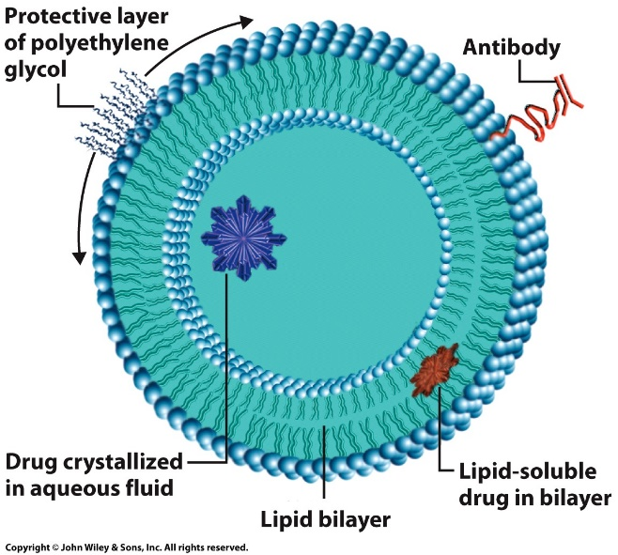
8.2 | The Lipid Composition of Membranes
The Nature and Importance of the Lipid Bilayer
The lipid bilayer can self-assemble, demonstrated easily in vitro.
Phospholipid molecules assemble spontaneously to form the walls of fluid-filled spherical vesicles, called liposomes.
Liposomes have proven invaluable in membrane research.
Membrane proteins can be inserted into liposomes and their function studied in a much simpler environment than that of a natural membrane.
Liposomes: synthetic vesicles
Notes:
Figure 8.9
Liposomes. A schematic diagram of a stealth liposome containing a hydrophilic polymer (such as polyethylene glycol) to protect it from destruction by immune cells, antibody molecules that target it to specific body tissues, a water-soluble drug enclosed in the fluid-filled interior chamber, and a lipid-soluble drug in the bilayer.
Liposome 이용
어떤 질환을 치료하고자 할 때 liposome 이용. → antibody 를 liposome 표면에 붙일 수 있음 → 몸 안에 침투시켜 반응을 기대
Hydrophilic 한 drug을 알약으로 만들었으면 → 소화기관을 통과하겠지. 여러 분해효소의 공격을 받을 수 있겠지 → liposome 에 집어넣고 이 자체를 약으로 이용하면
공격을 덜 받으니까 protection 해주니까 우리 몸 안에 더 오래 있을 수 있음 → 치료 효과를 더 기대해 볼 수 있음

Slide 23
8.2 | The Lipid Composition of Membranes
The Nature and Importance of the Lipid Bilayer
Liposomes are vehicles to deliver drugs or DNA within the body; they can be linked to the liposome wall or contained at high concentration within its lumen.
These walls are constructed to contain specific proteins for selective binding to the surfaces of particular target cells.
Stealth liposomes contain an outer polymer coating that protects the liposomes from immune destruction.
Caelyx, a stealth liposome containing doxorubicin, is an accepted therapy for treatment of metastatic breast cancer.
Liposomes: synthetic vesicles
Notes:
Figure 8.9
Liposomes. A schematic diagram of a stealth liposome containing a hydrophilic polymer (such as polyethylene glycol) to protect it from destruction by immune cells, antibody molecules that target it to specific body tissues, a water-soluble drug enclosed in the fluid-filled interior chamber, and a lipid-soluble drug in the bilayer.

Slide 24
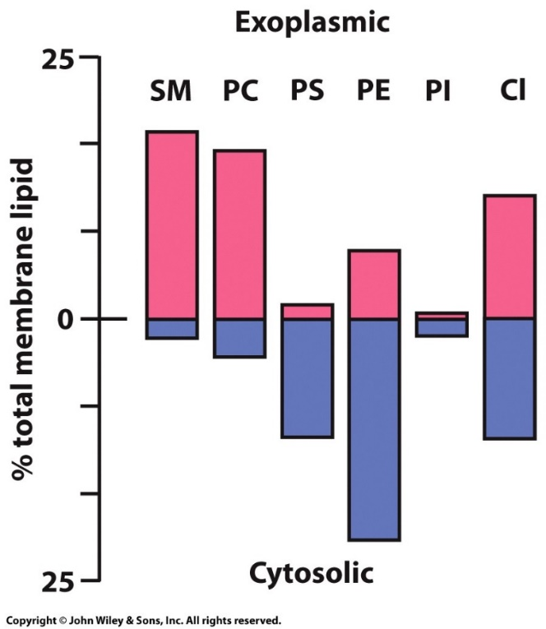
8.2 | The Lipid Composition of Membranes
The Asymmetry of the Membrane Lipids
The lipid bilayer consists of two distinct leaflets that have a distinctly different lipid composition.
Compared to the inner leaflet, the outer leaflet has a relatively high concentration of PC (and sphingomyelin) and a low concentration of PE and PS.
The lipid bilayer is composed of two semi-stable, independent monolayers having different physical and chemical properties.
SM: sphingomyelin
PC: phosphatidylcholine
PS: phosphatidylserine
PE: phosphatidylethanolamine
PI: phosphatidylinositol
Cl: cholesterol
Notes:
Figure 8.10
The asymmetric distribution of phospholipids (and cholesterol) in the plasma membrane of human erythrocytes. (SM, sphingomyelin; PC, phosphatidylcholine; PS, phosphatidylserine; PE, phosphatidylethanolamine; PI, phosphatidylinositol; Cl, cholesterol.)
세포의 종류가 달라지면 lipid 종류가 제각각
세포막도 세포 바깥쪽 lipid 가 있고 세포 안쪽 lipid 가 있지. (bilayer 니까)
바깥쪽 세포막엔 SM, PC가 많고 PE PS가 적다
안쪽 세포막엔 PS PE가 많고 SM PC가 적다
CL은 반반이고 PI는 둘 다 적네
어떤 lipid는 바깥쪽에 존재하고 어떤 lipid 는 주로 안쪽에 존재한다 → 각각의 기능과 다 연관이 있겠지

Slide 25
8.2 | The Lipid Composition of Membranes
The Asymmetry of the Membrane Lipids
Glycolipids are in the outer leaflet where they act as receptors for ligands.
PE (inner) promotes membrane curvature for membrane budding and fusion.
PS (inner) has a negative charge to bind positively charged lysine and arginine residues on adjacent proteins.
PS (outer) on aging lymphocytes marks the cells for destruction by macrophages.
PI (inner) can be phosphorylated, which converts the lipid into a phosphoinositide for signal transduction pathways.
SM: sphingomyelin
PC: phosphatidylcholine
PS: phosphatidylserine
PE: phosphatidylethanolamine
PI: phosphatidylinositol
Cl: cholesterol
Notes:
Figure 8.10
The asymmetric distribution of phospholipids (and cholesterol) in the plasma membrane of human erythrocytes. (SM, sphingomyelin; PC, phosphatidylcholine; PS, phosphatidylserine; PE, phosphatidylethanolamine; PI, phosphatidylinositol; Cl, cholesterol.)
<원리>
1. 안쪽
- PS (phosphatidylserine) ★★★★ : - charge 여서 → 인접 protein에 있는 lysine, arginine residue (+) 랑 결합 (그래서 질서정연하게 어느 한쪽에 몰려 있어 → Energy가 소모된다는 소리 = 엔트로피가 감소된 상태이니 → 만약 안쪽과 바깥쪽에 PS가 반반 있다는 소리는 이 세포가 죽은 세포 란 소리. 혹은 죽기 전 세포)
- PE 는 membrane 의 curvature (곡률) 촉진시킴 → budding fusion 할 때 기여
- PI : (딱히 언급 x)
2. 바깥쪽
- PS ★★★★ : 거의 없지만 일부가 있기도 함 → lymphocyte (나이든 || 죽은 세포) → macrophage (대식세포 → phagocyte 기능 有) 에게 이 세포 나이 들었으니까 얼른 파괴시켜 달라고 표시해주는 것 → phosphatidylserine 을 인식할 수 있는 부위 (receptor) 가 macrophage cell membrane 표면에도 있겠네.
- PC : Phosphatidylcholine also plays a role in membrane-mediated cell signaling and PCTP (phosphatidylcholine transfer protein (PCTP).^{[3]} ) activation of other enzymes.
=> 이건 안중요

Slide 26
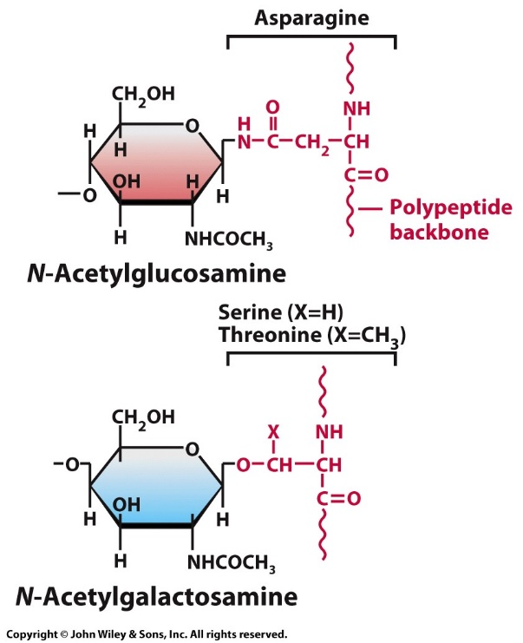
8.3 | Membrane Carbohydrates
Plasma membranes of eukaryotic cells have carbohydrate (2-10% by weight), with 90% glycoproteins and 10% glycolipids.
Carbohydrates face outward into the extracellular space, and internal cellular membranes faces away from the cytosol.
Glycoproteins have short, branched hydrophilic oligosaccharides (<15 sugars per chain) with extensive variability in composition and structure.
Oligosaccharides may be attached to several different amino acids by two types of linkages: N-linkages and O-linkages.
Two types of linkages that join sugars to a polypeptide chain
Notes:
Figure 8.11
Two types of linkages that join sugars to a polypeptide chain. The N-glycosidic linkage between asparagine and N-acetylglucosamine is more common than the O-glycosidic linkage between serine or threonine and N-acetylgalactosamine.
Glycosylation 은 세포 바깥 쪽으로만.
Glycosylation 이 되어 있지 않으면 활성을 띠지 않은 protein 이 多. (중요한 역할을 한다는 소리.)
N-glycosidic linkage vs O-glycosidic linkage
→ 뒷장에..

Slide 27
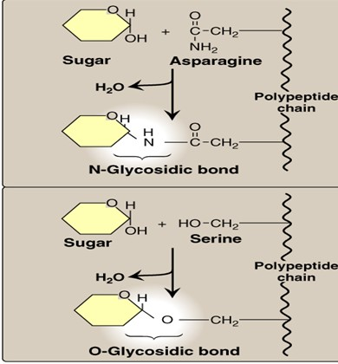
Notes:
N-glycosidic linkage vs O-glycosidic linkage
Glycosylation 도 post-translation 때 일어난다.
ER에 붙어있는 ribosome에서 만들어지는데, 그렇게 만들어진 단백질의 n-terminal 은 ER 안쪽에 C-terminal 은 cytoplasm에.. ER안에서 일어나는 glycosylation 이 일어나면, N-terminal 즉 ER 안쪽에 당이 붙어 있게 된다.
그리고 운반소낭 (vesicle) 을 형성 → plasma membrane 을 target 으로 해서 이동
(N-terminal 은 desk 안쪽에 위치하지)
plasma membrane 이랑 fusion 된다. → 그럼 N-terminal은 세포 바깥쪽을 향하지.
N-terminal은 cytoplasm이랑 만날 일이 없음.
★★★ 일반적으로 말하면, 소포체 내부의 환경은 세포 외부 환경과 굉장히 비슷함.
아까 봤듯이 소포체 내부로 향해 있던 N-terminal 이 운반된 이후, 세포 바깥으로 향하고 있지.

Slide 28
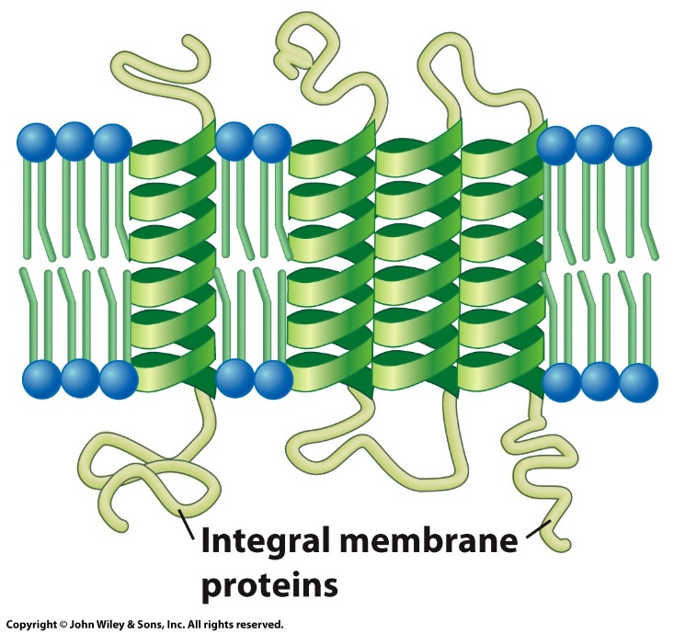
8.4 | Membrane Proteins
Membrane proteins attach to the bilayer asymmetrically, giving the membrane a distinct “sidedness”
Membrane proteins grouped into 3 classes:
Integral proteins: Penetrate and pass through lipid bilayer; make up 25 -30% of all encoded proteins and 60% of current drug targets.
Amphipathic- hydrophilic domains anchor them in the bilayer and hydrophilic regions form functional domains outside of the bilayer.
Channel proteins have hydrophilic cores that form aqueous channels in the membrane-spanning region.
Integral proteins
Notes:
Figure 8.13a-c
Three classes of membrane protein. (A) Integral proteins typically contain one or more transmembrane helices. (B) Peripheral proteins are non-covalently bonded to the polar head groups of the lipid bilayer and/or to an integral membrane protein. (C) Lipid-anchored proteins are covalently bonded to a lipid group that resides within the membrane. The lipid can be phosphatidylinositol, a fatty acid, or a prenyl group (a long-chain hydrocarbon built from five carbon isoprenoid units). I, inositol; GlcNAc, N-acetylglucosamine; Man, mannose; Etn, ethanolamine; GPI, glycosylphosphatidylinositol.
Integral protein : 세포막 관통해서 존재하는 protein → amphiphatic 한 성질을 가지고 있음.
약 개발할 때,
어떤 cell 표면의 protein을 target으로 하는 약 (표면 단백질에 약효 작용하니 굳이 세포
내부로 들어갈 필요 x)
Vs
Cell 내부 물질을 target으로 하는 약 (내부로 들어가야함)
전자가 더 만들기 쉽지. 그래서 integral protein 은 약 개발하는데 주된 target 이 되었다.
But, Integral protein을 연구하는 것이 더 어려움.
Why? → membrane 내에 파묻혀 있어서 membrane에서 분리해내기 어려움.
Peripheral protein : 세포 표면에 있는 protein

Slide 29
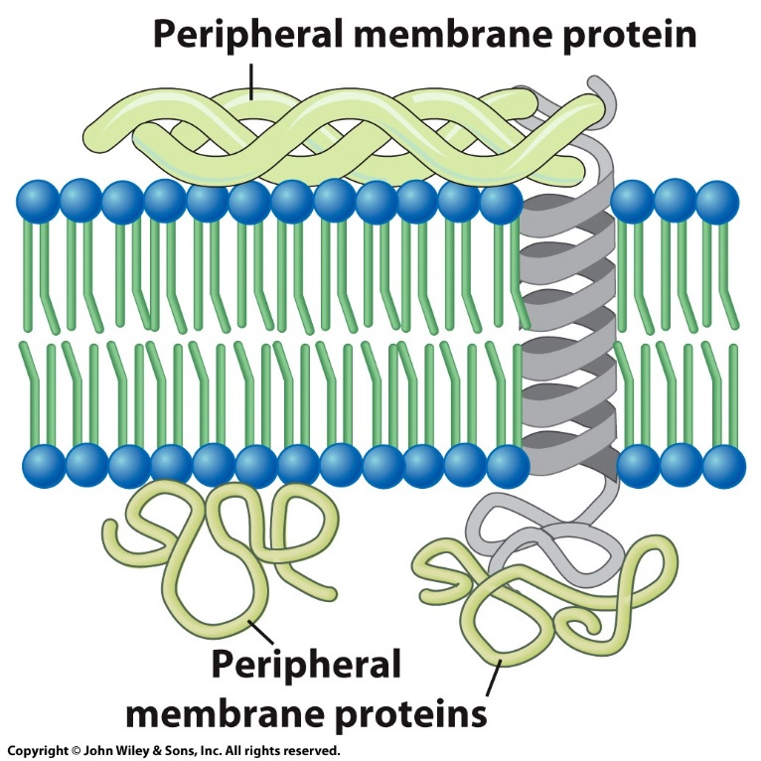
8.4 | Membrane Proteins
Membrane proteins can be grouped into three distinct classes:
Peripheral proteins: Attached to the membrane by weak bonds and are easily solubilized.
Located entirely outside of bilayer on either the extracellular or cytoplasmic side; associated with membrane surface by non-covalent bonds.
Peripheral proteins
Notes:
Figure 8.13a-c
Three classes of membrane protein. (A) Integral proteins typically contain one or more transmembrane helices. (B) Peripheral proteins are non-covalently bonded to the polar head groups of the lipid bilayer and/or to an integral membrane protein. (C) Lipid-anchored proteins are covalently bonded to a lipid group that resides within the membrane. The lipid can be phosphatidylinositol, a fatty acid, or a prenyl group (a long-chain hydrocarbon built from five carbon isoprenoid units). I, inositol; GlcNAc, N-acetylglucosamine; Man, mannose; Etn, ethanolamine; GPI, glycosylphosphatidylinositol.

Slide 30
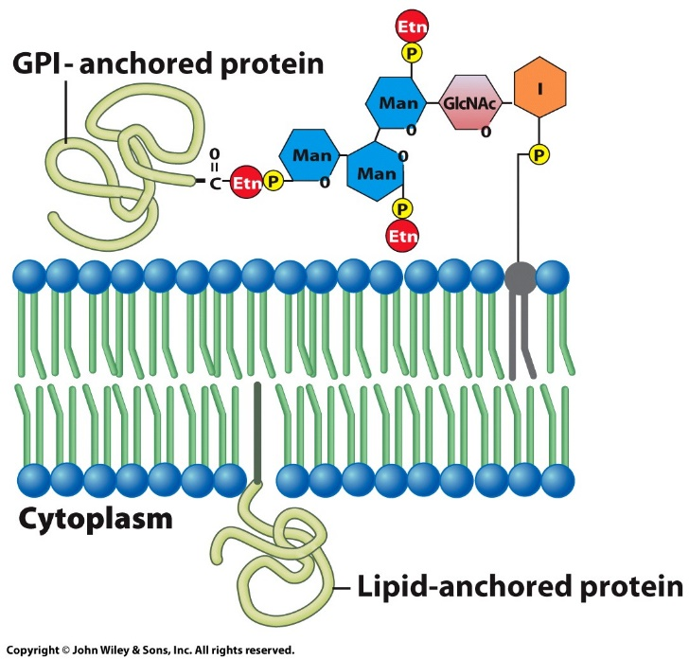

8.4 | Membrane Proteins
Membrane proteins can be grouped into three distinct classes:
Lipid-anchored membrane proteins are distinguished both by the types of lipid anchor and their orientation.
Glycophosphatidylinositol (GPI)-linked proteins found on the outer leaflet can be released by inositol-specific phospholipases.
Some inner-leaflet proteins are anchored to membrane lipids by long hydrocarbon chains.
Lipid-anchored proteins
Notes:
Figure 8.13a-c
Three classes of membrane protein. (A) Integral proteins typically contain one or more transmembrane helices. (B) Peripheral proteins are non-covalently bonded to the polar head groups of the lipid bilayer and/or to an integral membrane protein. (C) Lipid-anchored proteins are covalently bonded to a lipid group that resides within the membrane. The lipid can be phosphatidylinositol, a fatty acid, or a prenyl group (a long-chain hydrocarbon built from five carbon isoprenoid units). I, inositol; GlcNAc, N-acetylglucosamine; Man, mannose; Etn, ethanolamine; GPI, glycosylphosphatidylinositol.
Integral protein & Peripheral protein 말고도 특이한 protein이 더 발견됨.
GPI-linked proteins
PI = phosphatidylinositol 은 phospholipid 의 일종.
PI에 당이 붙어있으면 GPI.
Lipid-anchored membrane proteins.
Soluable protein 이 특정 amino acid side chain 에 FA가 공유결합한 경우
그래서, 그 FA 부분이 cell membrane 에 박혀 있는 경우
ex. Ras protein : 신호 전달 과정에서 아주 중요한 조절 역할을 하는 protein
그래서 이 작용에 문제가 생기면 암을 유발시킨다. (oncogene)
→ 얜 soluable 해서 cytoplasm에 위치하게 됨. 얘가 어떤 protein 에 작용해 그 protein을 활성화시켜 주는데, 이 반응은 plasma membrane 근처에서 일어 남.
그래서 얜 membrane 근처에 있을 때 자기 기능을 제대로 발휘할 수 있다. FA와 공유결합해서 그 FA부분이 PM에 anchored 되어 기능 발휘.

Slide 31
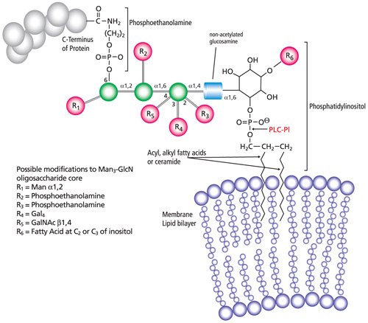
Notes:
GPI-anchored proteins
➔ Glycosylphosphatidylinisotol (GPI) anchored proteins
PI : Phosphatidylinositol (inositol이 저 고리모양 탄소 골격)
Phospholipid 의 일종
거기에 phosphoethanolamine + trimannosyl-nonacetylated glucosamine 이 붙어있는 것.

Slide 32
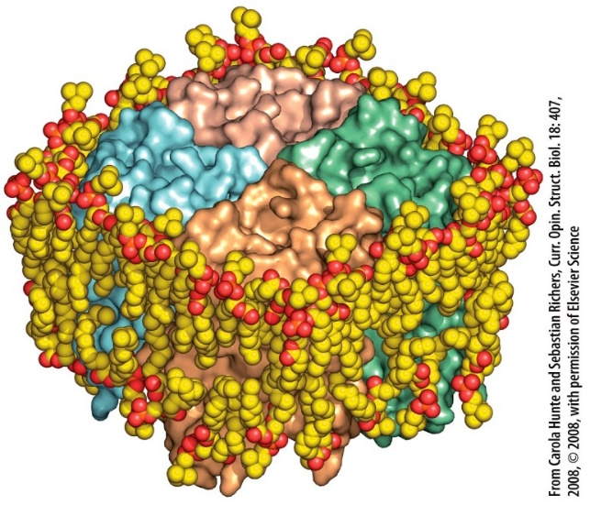
8.4 | Membrane Proteins
Integral Membrane Proteins
Integral membrane proteins function as receptors that bind ligands, channels or transporters to move ions/solutes across the membrane, or agents that transfer electrons during photosynthesis and respiration.
They are amphipathic, having both hydrophilic and hydrophobic portions; the hydrophobic transmembrane domains form van der Waals interactions with the fatty acyl chains of the bilayer.
This preserves the permeability barrier of the membrane, since the protein is anchored within the bilayer and has direct contact with surrounding lipid molecules.
Driven by van der Waals forces between amino acids and lipids, proteins can be surrounded by a closely applied shell of lipid molecules.
Notes:
Figure 8.14a, b
The interactions between membrane proteins and lipids. (a) Aquaporin is a membrane protein containing four subunits (colored differently in the illustration) with each subunit containing an aqueous channel. Analysis of the protein’s structure revealed the presence of a surrounding layer of bound lipid molecules. In this case, these lipid molecules are not likely to play a role in the function of aquaporin because the protein retains its function as a water channel in bilayers containing nonnative lipids. (b) Two views of another tetrameric membrane protein, in this case the bacterial K+ channel, KcsA. Anionic phosphatidylglycerol molecules (red/gray) are seen in each crevice between the subunits and are thought to be required for normal channel function. A K+ ion (purple sphere) is seen in transit through the pore.
SOURCE: (a) From Carola Hunte and Sebastian Richers, Curr. Opin. Struct.throughout
Biol. 18:407, © 2008, with permission from Elsevier Science; (b) From Anthony G. Lee, Trends Biochem. Sci. 36:497, © 2011, with permission from Elsevier Science.

Slide 33
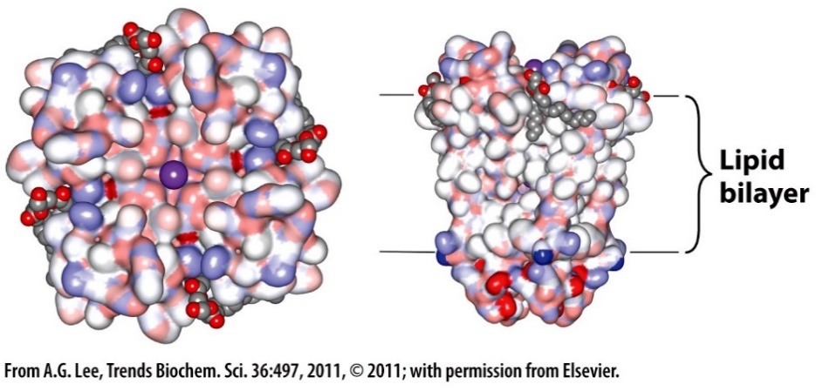
8.4 | Membrane Proteins
Integral Membrane Proteins
Most lipid molecules that make contact with a transmembrane domain are rapidly exchanged with other lipid molecules in the bilayer.
Specific sites on membrane proteins can form important functional interactions with specific lipid molecules.
Anionic lipid molecules can bind at subunit interfaces of a tetrameric KcsA K⁺ channel.
The channel does not open normally in a bilayer that lacks these specific lipid molecules.
Views of a tetrameric membrane protein, the bacterial K+ channel
Notes:
Figure 8.14a, b
The interactions between membrane proteins and lipids. (a) Aquaporin is a membrane protein containing four subunits (colored differently in the illustration) with each subunit containing an aqueous channel. Analysis of the protein’s structure revealed the presence of a surrounding layer of bound lipid molecules. In this case, these lipid molecules are not likely to play a role in the function of aquaporin because the protein retains its function as a water channel in bilayers containing nonnative lipids. (b) Two views of another tetrameric membrane protein, in this case the bacterial K+ channel, KcsA. Anionic phosphatidylglycerol molecules (red/gray) are seen in each crevice between the subunits and are thought to be required for normal channel function. A K+ ion (purple sphere) is seen in transit through the pore.
SOURCE: (a) From Carola Hunte and Sebastian Richers, Curr. Opin. Struct.throughout
Biol. 18:407, © 2008, with permission from Elsevier Science; (b) From Anthony G. Lee, Trends Biochem. Sci. 36:497, © 2011, with permission from Elsevier Science.

Slide 34
8.4 | Membrane Proteins
Integral Membrane Proteins
Protein domains that project into either the cytoplasm or extracellular space tend to be like the globular proteins, with hydrophilic surfaces that interact with water-soluble substances.
Transmembrane domains can be devoid of water molecules, while others allow the water to penetrate deeply.
Large families of membrane proteins contain an interior channel with key hydrophilic residues at strategic locations that provides an aqueous passageway through the lipid bilayer.
Integral proteins need not be fixed structures but may be able to move laterally within the membrane.
Notes:
Plasma membrane 의 fluidity 때문에 protein 이나 lipid 도 movement가 있다.
Fluidity 가 왜 중요하냐
Ex. 어떤 ligand 가 Binding site를 2개 가지고 있다 치면, 2개 떨어져 있는 Receptor 에 동시 결합 못해.
Receptor 가 거리 가까워져서 ligand 1개가 2개 receptor 에 동시 결합.
두 receptor 가 활성화 되고 둘이 상호작용해서 반응 진행하는 경우 많음.

Slide 35
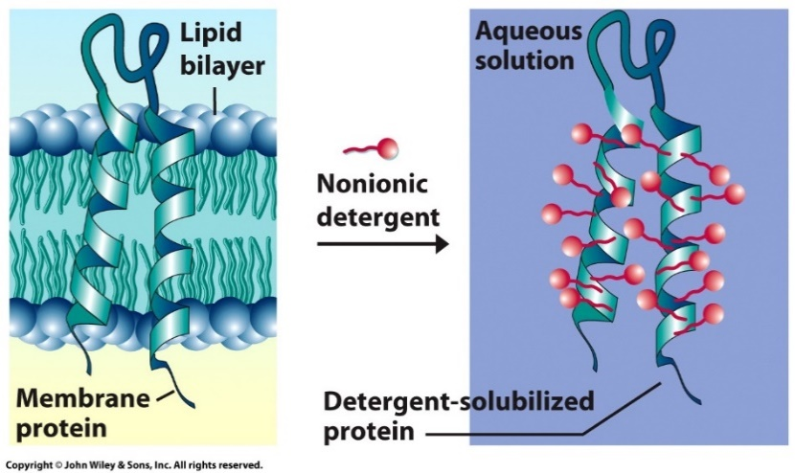
8.5 | Studying the Structure and Properties of Integral Membrane Proteins
Hydrophobic transmembrane domains make integral membrane proteins difficult to isolate in a soluble form.
Their isolation from membranes requires detergents like ionic SDS, which denatures proteins, or nonionic Triton X-100, doesn’t alter a protein’s tertiary structure.
Detergents are amphipathic and can substitute for phospholipids in stabilizing and solubilizing integral proteins.
After purification, the protein’s amino acid composition, molecular mass, and amino acid sequence can be determined.
Solubilization of membrane proteins with detergents
Notes:
Figure 8.16
Solubilization of membrane proteins with detergents. The nonpolar ends of the detergent molecules associate with the nonpolar residues of the protein that had previously been in contact with the fatty acyl chains of the lipid bilayer. In contrast, the polar ends of the detergent molecules interact with the surrounding water molecules, keeping the protein in solution. Nonionic detergents, as shown here, solubilize membrane proteins without disrupting their structure.
Cell membrane 에 존재하는 integral protein을 Purification 해서 연구해야 함.
But 분리 힘들어. → 분리하는 연구 多
detergent 를 사용. : 얘도 amphipathic 한 성질이 있음.
세포 내에 존재하는 구조를 최대한 유지하면서 분리해야 함. 그런 환경을 만들어 주는게 detergent.
Detergent가 charge를 가지고 있는지 여부를 기준으로 분류
Non ionic detergent : 수소결합은 가능 but charge 는 없지. 순한 detergent
Ionic detergent: charg가 있어 protein 구조를 많이 변형시킨다. (denaturation 多多)

Slide 36
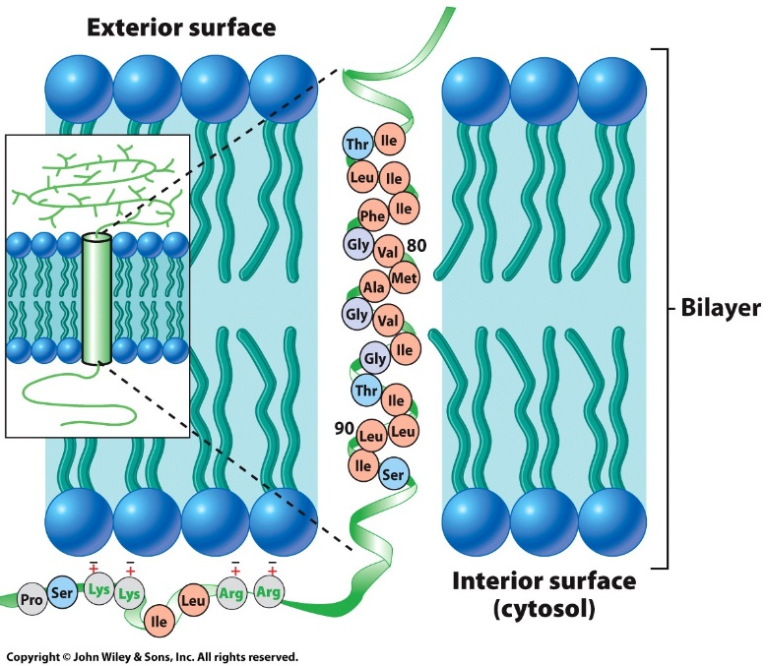
8.5 | Studying the Structure and Properties of Integral Membrane Proteins
Identifying Transmembrane Domains
Protein segments embedded within the membrane, or transmembrane domains, have a string of about 20 mostly nonpolar amino acids that span the lipid bilayer as an α helix.
The chemical structure of glycophorin A, the major integral protein of the erythrocyte plasma membrane, shows that 17 of 20 amino acids in the α helix have hydrophobic side chains.
Glycophorin A, an integral protein with a single transmembrane domain with a Gly-X-X-X-Gly sequence
Notes:
Figure 8.18
Glycophorin A, an integral protein with a single transmembrane domain. The single alpha-helix that passes through the membrane consists predominantly of hydrophobic residues (orange-colored circles). The four positively charged amino acid residues of the cytoplasmic domain of the membrane form ionic bonds with negatively charged lipid head groups. Carbohydrates are attached to a number of amino acid residues on the outer surface of the protein (shown in the inset). All but one of the 16 oligosaccharides are small O-linked chains (the exception is a larger oligosaccharide linked to the asparagine residue at position 26). Glycophorin molecules are present as homodimers within the erythrocyte membrane. The two helices cross over one another in the region between residues 79 and 83. This Gly-X-X-X-Gly sequence is commonly found where transmembrane helices come into close proximity.
Transmembrane protein: 막 통과 단백질
세포막 전체에 걸쳐 있는 일체형 막 단백질의 유형. 특정 물질 수송 허용해주는 통로 제공.
단백질의 single alpha helix 부분이 주로 transmembrane domain 을 차지하는 경우 多
Interial surface 의 AA Side chain에 charge 가 있는 amino acid가 오는 경우가 많음 (다 그런건 아니고) → 그림 보셈.

Slide 37
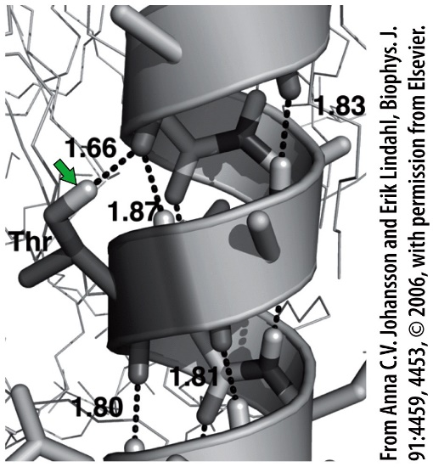
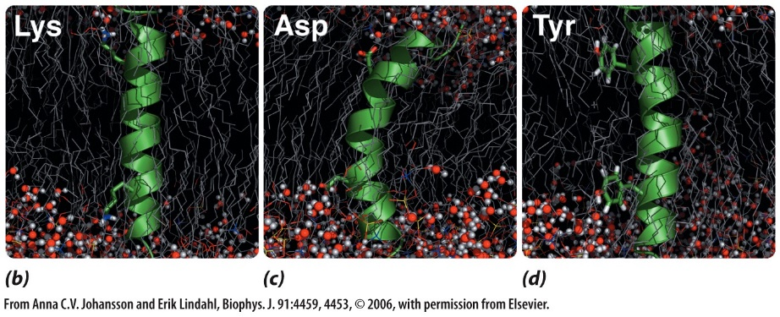
8.5 | Studying the Structure and Properties of Integral Membrane Proteins
Identifying Transmembrane Domains
The hydroxyl group threonine residue in the transmembrane domain can hydrogen bond with an oxygen atom of the peptide backbone.
Fully charged residues can be found in transmembrane helices, but they tend to be near one of the ends of the helix where they can extend their residues into the polar or aqueous environment.
Hydrophobic aromatic side chains of tyrosine residues can be oriented parallel with hydrocarbon chains of the bilayer.
Accommodating nonpolar amino acid residues in transmembrane helices
Notes:
Figure 8.19a-d
Accommodating various amino acid residues within transmembrane helices. (A) In this portrait of a small portion of a transmembrane helix, the hydroxyl group of the threonine side chain (arrow) is able to form a (shared) hydrogen bond with a backbone oxygen within the lipid bilayer. Hydrogen bonds are indicated by the dashed lines and their distances are shown in angstroms. (B) The side chains of the two lysine residues of this transmembrane helix are sufficiently long and flexible to form bonds with the head groups and water molecules of the polar face of the lipid bilayer. (C) The side chains of the two aspartic acid residues of this transmembrane helix can also reach the polar face of the bilayer but introduce distortion in the helix to do so. (D) The aromatic side chains of the two tyrosine residues of this transmembrane helix are oriented perpendicular to the axis of the membrane and parallel to the fatty acyl chains with which they interact.

Slide 38
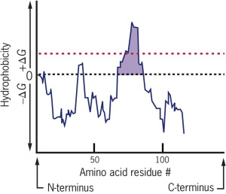
8.5 | Studying the Structure and Properties of Integral Membrane Proteins
Identifying Transmembrane Domains
Can identify transmembrane segments using a hydropathy plot, which measures the hydrophobicity of the amino acid at that site as well as that of its neighbors.
Hydrophobicity of amino acids can be determined from their lipid solubility or energy required to transfer them from a nonpolar into an aqueous medium.
Transmembrane segments are peaks in the hydrophobic side of the spectrum.
Orientation within the bilayer: cytoplasmic flank of a segment is more positively charged than at the extracellular flank.
Hydropathy plot for glycophorin A demonstrates a single pass domain
Notes:
Figure 8.20
Glycophorin A, an integral protein with a single transmembrane domain. The single alpha-helix that passes through the membrane consists predominantly of hydrophobic residues (orange-colored circles). The four positively charged amino acid residues of the cytoplasmic domain of the membrane form ionic bonds with negatively charged lipid head groups. Carbohydrates are attached to a number of amino acid residues on the outer surface of the protein (shown in the inset). All but one of the 16 oligosaccharides are small O-linked chains (the exception is a larger oligosaccharide linked to the asparagine residue at position 26). Glycophorin molecules are present as homodimers within the erythrocyte membrane. The two helices cross over one another in the region between residues 79 and 83. This Gly-X-X-X-Gly sequence is commonly found where transmembrane helices come into close proximity.
Figure 8.20
Hydropathy plot for glycophorin A, a single membrane-spanning protein. Hydrophobicity is measured by the free energy required to transfer each segment of the polypeptide from a nonpolar solvent to an aqueous medium. Values above the 0 line are energy-requiring (+Gs), indicating they consist of stretches of amino acids that have predominantly nonpolar side chains. Peaks that project above the red-colored line are interpreted as a transmembrane domain.
Hydropathy plot 이란 방법
: protein 의 amino acid 의 side chain ( R ) 이 얼마나 hydrophobic 한지를 측정하는 것
그래프 그리면 위와 같이 나옴.
( C-terminal / N-terminal 이 세포 바깥에 있는지 안쪽에 있는지는 모르는 거고. )
얻을 수 있는 것 : 0을 기준으로 보면
대략 40번째 aa 2~3개 + 75번째 aa 근처 연속적으로 20개 정도 (여기가 transmembrane
domain 부분이겠네.)
이 protein 이 membrane protein 인지 아닌지를 알 수 있지.
초기 protein 을 발견했을 때, 제일 먼저 하는 실험임. : 막 단백질인지 세포 내 단백질인지.

Slide 39
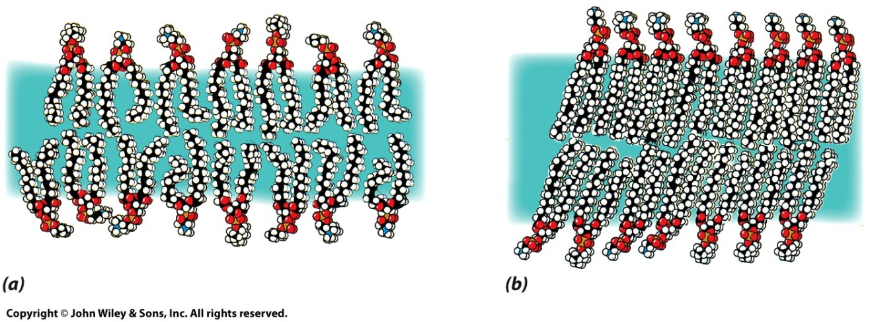
8.6 | Membrane Lipids and Membrane Fluidity
Physical state of the membrane lipid is described by its fluidity or viscosity.
If the temperature of the bilayer is kept relatively warm (37ºC), the lipid exists in a relatively fluid state, and is described as a two-dimensional liquid crystal.
Molecules retain a specified orientation; the long axes are parallel, yet individual lipids can rotate around their axis or move laterally within the plane.
If the temperature is slowly lowered to the transition temperature, the lipid is converted to a frozen crystalline gel and movement is greatly restricted.
Structure of the lipid bilayer depends on the temperature:
above and below the transition temperature.
Notes:
Figure 8.23a, b
The structure of the lipid bilayer depends on the temperature. The bilayer shown here is composed of two phospholipids: phosphatidylcholine and phosphatidylethanolamine. (A) Above the transition temperature, the lipid molecules and their hydrophobic tails are free to move in certain directions, even though they retain a considerable degree of order. (B) Below the transition temperature, the movement of the molecules is greatly restricted, and the entire bilayer can be described as a crystalline gel.
Fluidity 결정 factor
온도
FA ( saturated? Unsaturated?)

Slide 40
8.6 | Membrane Lipids and Membrane Fluidity
Saturated fatty acids resemble a straight, flexible rod, while cis-unsaturated fatty acids have crooks in the chain at the sites of a double bond. Saturated chains pack together more tightly than those containing unsaturated chains.
The greater the degree of unsaturation of the fatty acids of the bilayer, the lower the temperature before the bilayer gels.
The shorter the fatty acyl chains, the lower its melting temperature.
Cholesterol abolishes sharp transition temperatures and creates a condition of intermediate fluidity; it increases membrane durability and decreases membrane permeability.
Notes:
PM의 구조, 구성을 변화시켜야 membrane 의 fluidity 가 변함.
Phospholipid 의 뼈대 → glycerol 로 시작해서 ester linkage로 2개의 fatty acid 연결되어 있고, 3번 탄소에는 phosphate group 과 ester 결합을 하고, 그 phosphate group에는 hydrophilic group이 이어져 있음.
Desaturated FA vs saturated FA
1. desaturase
Desaturate를 촉진시켜 주는 enzyme 이 있음 → 특히 cis 구조로 desaturate 시켜주면 fluidity 증가
2. FA 교체, 교환 ( phospholipase )
기존의 FA를 떼어내고 다른 FA를 붙여 fluidity 변화시킴.
Phospholipase : phospholipid를 가수분해하는 효소
PLA1 ( phospholipase A1 ) : 1번 탄소의 ester linkage 를 끊음
PLA2 ( phospholipase A2 ) : 2번 탄소의 ester linkage 를 끊음
PLC ( phospholipase c ) : 3번 탄소의 phosphate 와의 ester linkage 를 끊음
PLD ( phospholipase d ) : 3번 탄소에 달린 phosphate와 choline 의 공유결합을 끊음
PLA1 PLA2 만 FA 교체에 관여하지.
PLC PLD 는 Cell signaling ( second messenger ) 에 관여함

Slide 41
8.6 | Membrane Lipids and Membrane Fluidity
The Importance of Membrane Fluidity
Membrane fluidity provides a compromise between a rigid, ordered structure lacking mobility and a completely fluid, non-viscous liquid lacking structural organization and mechanical support.
Fluidity allows for interactions to occur; clusters of membrane proteins can assemble at particular sites and form specialized structures. Molecules can come together, carry out a necessary reaction, and move apart.
Membranes arise from preexisting membranes, and their growth occurs by the insertion of lipids and proteins into the fluid matrix.
Cellular processes, including cell movement, cell growth, cell division, formation of intercellular junctions, secretion, and endocytosis, depend on the movement of membrane components and would probably not be possible if membranes were rigid, non-fluid structures.
Notes:
아까 말했듯이 protein 끼리 interaction 을 하려면 fluidity 가 필요하지.
그 외에도..
Cell migration / cell growth / cell division / Endocytosis (세포내 이입) / exocytosis / ….

Slide 42
8.6 | Membrane Lipids and Membrane Fluidity
Maintaining Membrane Fluidity
Internal temperatures of most organisms can fluctuate with the temperature, so cells respond by altering phospholipid composition. If the temperature is lowered, cells can remodel membranes to make them more cold resistant.
Remodeling is accomplished by (1) desaturating single bonds in fatty acyl chains to form double bonds, and (2) reshuffling chains between different phospholipid molecules to make ones that have two unsaturated fatty acids.
Desaturation is catalyzed by desaturases, while reshuffling is accomplished by phospholipases, which split the fatty acid from the glycerol backbone, and acyl- transferases, which transfer fatty acids between phospholipids.
In addition, the cell changes the types of phospholipids being synthesized in favor of ones containing more unsaturated fatty acids.

Slide 43
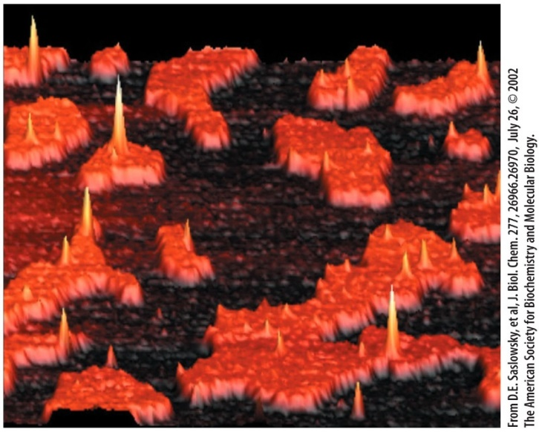
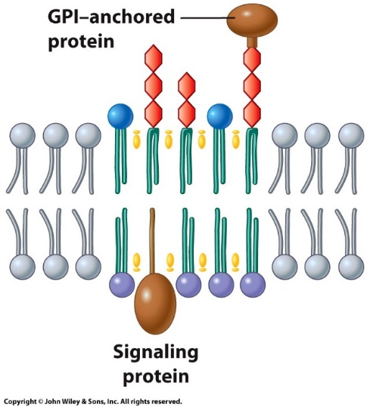
8.6 | Membrane Lipids and Membrane Fluidity
Lipid Rafts
Sphingomyelin organizing into orange-colored rafts
Schematic model of a lipid raft
The outer leaflet of plasma membrane contains specialized regions.
Cholesterol and sphingolipids tend to pack together to form highly ordered microdomains forming lipids rafts that float within the more fluid and disordered environment.
They provide a favorable environment for cell-surface receptors and GPI-anchored proteins.
Notes:
Figure 8.24a, b
Lipid rafts. (A) Image of the upper surface of an artificial lipid bilayer containing phosphatidylcholine, which appears as the black background, and sphingomyelin molecules, which organize themselves spontaneously into the orange-colored rafts. The yellow peaks show the positions of a GPI-anchored protein, which is almost exclusively raft associated. This image is provided by an atomic force microscope, which measures the height of various parts of the specimen at the molecular level. (B) Schematic model of a lipid raft within a cell. The outer leaflet of the raft consists primarily of cholesterol (yellow) and sphingolipids (red head groups). Phosphatidylcholine molecules (blue head groups) with long saturated fatty acids also tend to concentrate in this region. GPI-anchored proteins are thought to become concentrated in lipid rafts. The lipids in the outer leaflet of the raft have an organizing effect on the lipids of the inner leaflet. As a result, the inner-leaflet raft lipids consist primarily of cholesterol and glycerophospholipids with long saturated fatty acyl tails. The inner leaflet tends to concentrate lipid anchored proteins, such as Src kinase, that are involved in cell signaling.
< Lipid Rafts >
PM의 어떤 특정 지역은 다른 인접 지역에 비해 fluidity 가 떨어짐.
Receptor 역할을 하는 protein / integral protein 이 있는 지역.
Cholesterol / sphingolipid 가 pack together 시켜주는 역할을 함.

Slide 44
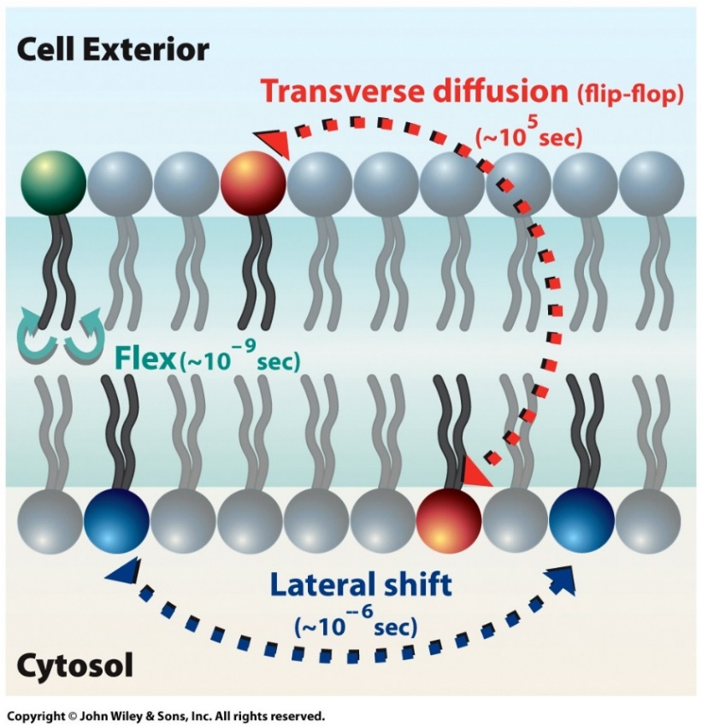
8.7 | The Dynamic Nature of the Plasma Membrane
A phospholipid can move laterally within the same leaflet with considerable ease.
A phospholipid can diffuse from one end of a bacterium to the other end in a second or two, but it takes hours to days to move across to the other leaflet.
To flip-flop, the hydrophilic head of the lipid must pass through the internal hydrophobic sheet of the membrane.
Flippases are enzymes that move certain phospholipids from one leaflet to the other.
The possible movements of phospholipids in a membrane
Notes:
Figure 8.25
The possible movements of phospholipids in a membrane. The types of movements in which membrane phospholipids can engage and the approximate time scales over which they occur. Whereas phospholipids move from one leaflet to another at a very slow rate, they diffuse laterally within a leaflet rapidly. Lipids lacking polar groups, such as cholesterol, can move across the bilayer quite rapidly.
<이동 가능한 경우와 빈도>
1.Outer phospholipid 가 inner phospholipid 로 이동 = Flip-flop (잘 일어나지 않음)
→ flippase
2. 측면을 이동 (흔하게 일어 남)
< Flippase >
- ex. Phosphatidylserine는 inner layer에 거의 존재하는데, 여기에 관여한 enzyme이 flippase 이다. 에너지를 써가면서 phosphatidylserine이 바깥에 노출되는 가능성을 낮추기 위해 flippase 가 안쪽으로 flip-flop 시켜주는 것.

Slide 45
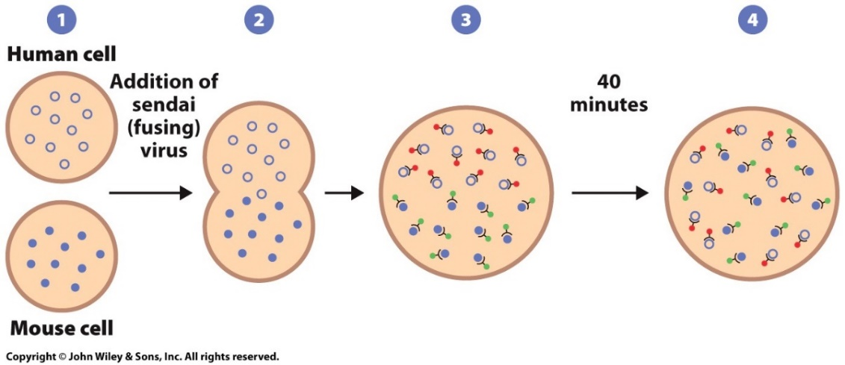
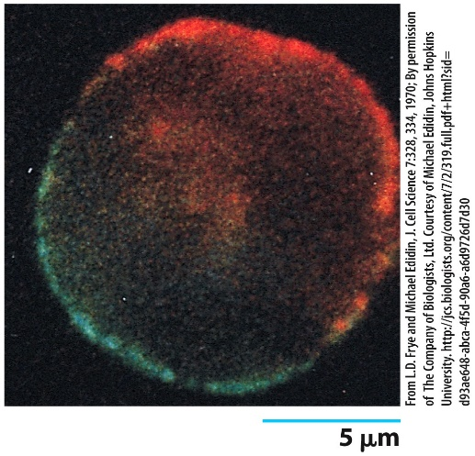
8.7 | The Dynamic Nature of the Plasma Membrane
The Diffusion of Membrane Proteins after Cell Fusion
Cell fusion to reveal mobility of membrane proteins: fusion of human and mouse cells
Cell fusion is a technique whereby two different types of cells, or cells from two different species, can be fused to produce one cell with a common cytoplasm and a single, continuous plasma membrane.
Cell fusion be induced by certain viruses, or with polyethylene glycol.
Labeled proteins have shown that membrane proteins can move between fused cell.
Notes:
Figure 8.26a, b
The use of cell fusion to reveal mobility of membrane proteins. (A) Outline of the experiment in which human and mouse cells were fused (steps 1–2) and the distribution of the proteins on the surface of each cell were followed in the hybrids over time (steps 3–4). Mouse membrane proteins are indicated by solid circles, human membrane proteins by open circles. Locations of human and mouse proteins in the plasma membranes of the hybrid cells were monitored by interaction with fluorescent red and fluorescent green antibodies, respectively. (B) Micrograph showing a fused cell in which mouse and human proteins are still in their respective hemispheres (equivalent to the hybrid in step 3 of part A).
두 세포를 융합 시켜 봄
A cell 에만 있는 intergral protein 있고
B cell 에만 잇는 intergral protein 이 있을 것임.
막 fusion 되었을 땐, open circle 과 close circle의 위치가 각자 반 씩 차지하고 있을 것임
근데 시간이 지나고 봤을 땐, random 하게 분포되어 있을 것이다.
관찰을 위해서 형광을 띄고 있는 물질 ( 특정 cell의 receptor에만 결합하는 ) fusion 이전에 처리.

Slide 46
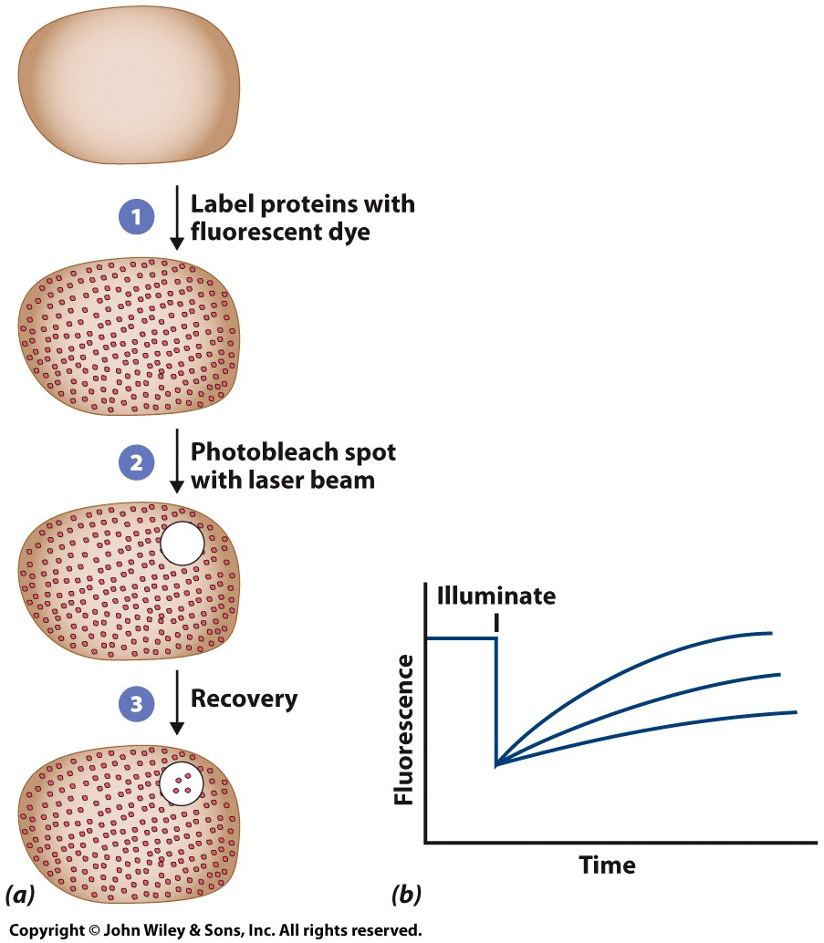
8.7 | The Dynamic Nature of the Plasma Membrane
Restrictions on Protein and Lipid Mobility
Measuring the diffusion rates of membrane proteins by FRAP: variable nature of fluorescence recovery is dependent upon the protein examined
Proteins can be labeled and tracked by fluorescence recovery after photobleaching (FRAP) and single particle tracking (SPT).
Proteins can be immobile, mobile in a directed manner, or exhibit random movement.
Notes:
Figure 8.27a, b
Measuring the diffusion rates of membrane proteins by fluorescence recovery after photobleaching (FRAP). (A) In this technique, a particular component of the membrane is first labeled with a fluorescent dye (step 1). A small region of the surface is then irradiated to bleach the dye molecules (step 2), and the recovery of fluorescence in the bleached region is followed over time (step 3). (N represents the cell nucleus.) (B) The rate of fluorescence recovery within the illuminated spot can vary depending on the protein(s) being followed. The rate of recovery is related to the diffusion coefficient of the fluorescently labeled protein.
→ 어떤 integral protein 의 fluidity 를 정량적으로 관찰 가능
FRAP ( fluorescence recovery after photobleaching ) : 어떤 region을 형광 현미경으로 관찰할 때, 여기에 계속 특정 빛을 쬐어 주면 bleaching 이 일어난다. ( 하얗게 변함. )
1st : 우선 형광 물질로 PM의 특정 요소를 염색 시켜
2nd : 그리고 특정 부분만 레이저를 쏴 FRAP을 통해 bleaching 시켜 (표백) 하얗게 만들어.
3rd : recovery되는 속도를 관찰

Slide 47
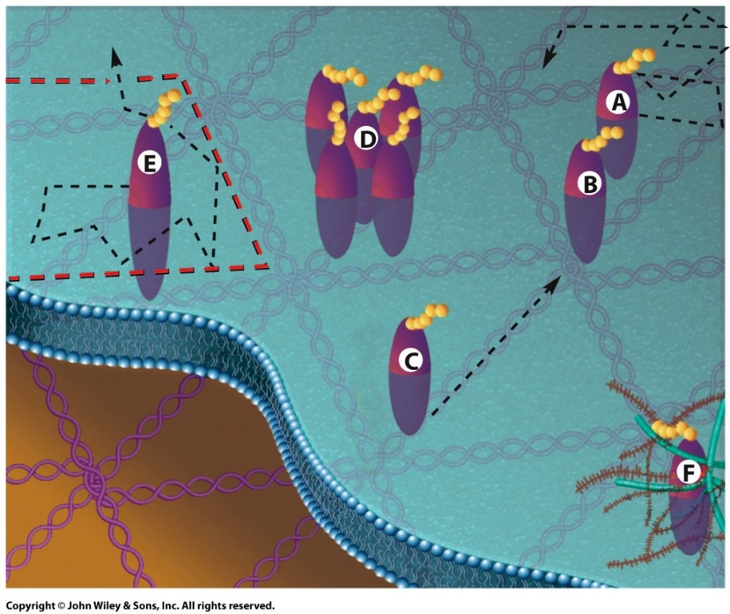
Patterns of movement of integral membrane proteins
8.7 | The Dynamic Nature of the Plasma Membrane
Control of Membrane Protein Mobility
Protein movements are slower than predicted by protein size and membrane viscosity.
Protein movements are limited by interactions with the cytoskeleton, other proteins, and extracellular materials.
Techniques that can drag tagged proteins within the membrane, indicate that some proteins have barriers to lateral diffusion.
Genetically modified proteins missing either intracellular or extracellular domains are less restricted.
Notes:
Figure 8.28
Patterns of movement of integral membrane proteins. Depending on the cell type and the conditions, integral membrane proteins can exhibit several different types of mobility. Protein A is capable of diffusing randomly throughout the membrane, though its rate of movement may be limited; protein B is immobilized as the result of its interaction with the underlying membrane skeleton; protein C is being moved in a particular direction as the result of its interaction with a motor protein at the cytoplasmic surface of the membrane; movement of protein D is restricted by other integral proteins of the membrane; movement of protein E is restricted by fences formed by proteins of the membrane skeleton, but it can hop into adjacent compartments through transient openings in a fence; movement of protein F is restrained by extracellular materials.
Protein 의 구조가 달라지면 movement 도 달라짐

Slide 48
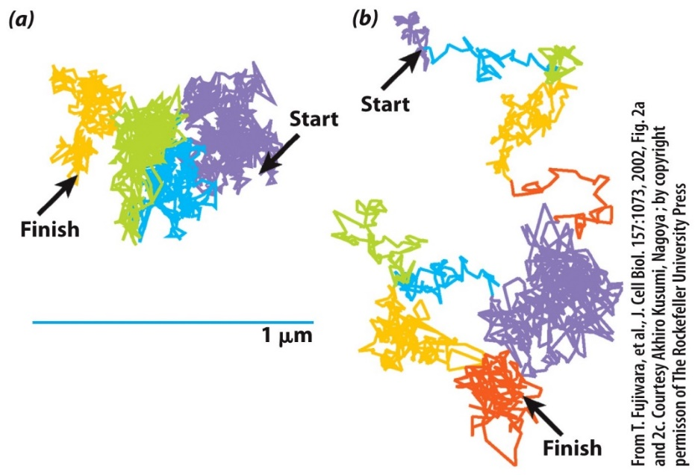
Experimental demonstration that diffusion of phospholipids within the plasma membrane is confined
8.7 | The Dynamic Nature of the Plasma Membrane
Membrane Lipid Mobility
Phospholipid diffusion is restricted within the bilayer.
Phospholipids are confined for very brief periods to certain areas and then hop from one confined area to another.
Fences restricting motion are constructed of rows of integral membrane proteins bound to the membrane skeleton by their cytoplasmic domains.
Notes:
Figure 8.29a, b
Experimental demonstration that diffusion of phospholipids within the plasma membrane is confined. (A) The track of a single labeled unsaturated phospholipid is followed for 56 ms as it diffuses within the plasma membrane of a rat fibroblast. Phospholipids diffuse freely within a confined compartment before hopping into a neighboring compartment. The rate of diffusion within a compartment is as rapid as that expected by unhindered Brownian movement. However, the overall rate of diffusion of the phospholipid appears slowed because the molecule must hop a barrier to continue its movement. The movement of the phospholipid within each compartment is represented by a single color. (B) The same experiment shown in A is carried out for 33 ms in an artificial bilayer, which lacks the “picket fences” present in a cellular membrane. The much more open, extended trajectory of the phospholipid can now be explained by simple, unconfined Brownian movement. For the sake of comparison, fake compartments were assigned in B and indicated by different colors.

Slide 49
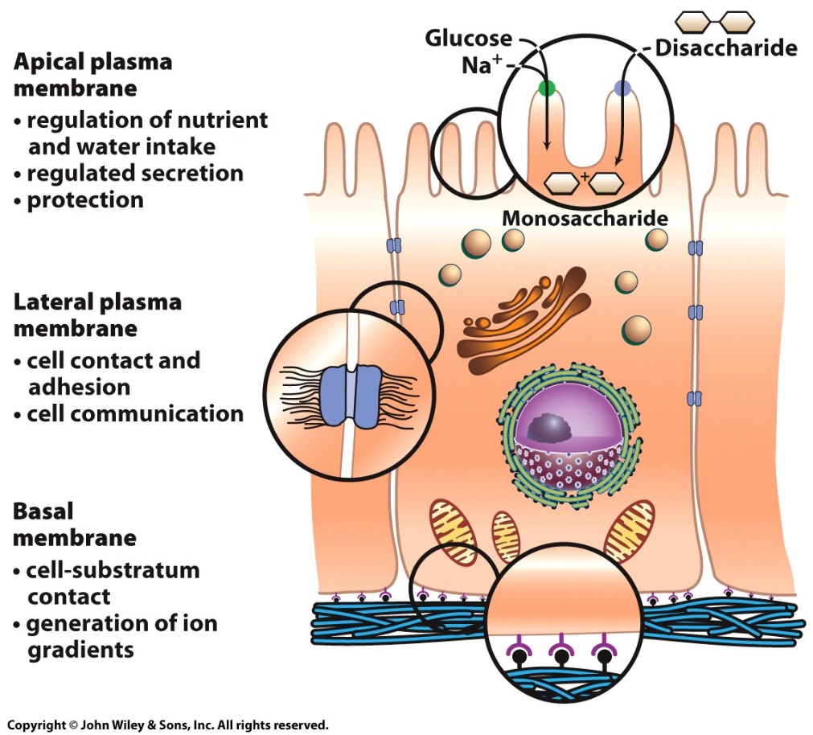
8.7 | The Dynamic Nature of the Plasma Membrane
Membrane Domains and Polarity
Most membranes vary in protein composition and mobility.
Epithelial cells of the intestinal wall or kidney tubules are highly polarized whose surfaces carry out different functions.
The apical plasma membrane absorbs substances from the lumen; the lateral plasma membrane interacts with neighboring epithelial cells; the basal membrane adheres to an underlying basement membrane.
Differentiated functions of the plasma membrane of an epithelial cell.
Notes:
Figure 8.30
Differentiated functions of the plasma membrane of an epithelial cell. The apical surface of this intestinal epithelial cell contains integral proteins that function in ion transport and hydrolysis of disaccharides, such as sucrose and lactose; the lateral surface contains integral proteins that function in intercellular interaction; and the basal surface contains integral proteins that function in the association of the cell with the underlying basement membrane.
Epithelial cell 은 방향성이 존재함 (위 아래 측면의 구조, 구성이 다 다름)
Basal PM (Bottom) : 이를 이루는 protein layer (extracellular matrix 의 일종)가 있음. -> extracellular matrix 와 ligand- receptor interaction을 하고 있어야 이 cell은 생존 가능. (그래서 monolayer 밖에 형성하지 못하는 것임. )
→ anoikis : 그리스어로 homeless 라는 뜻 ( 저 ligand-receptor interaction 이 주는 signal 이 cell 생존에 매우 중요한 역할. )
➔ 떨어져 나가도 죽지 않으면 이 세포를 암세포라고 하는 것이고, 정상세포가 못하는 전이를 암세포는 할 수 있다.( 암의 전이 )
➔ Anoikis is ‘programmed cell death’ caused by disruption of cell-substrate adhesion in normal epithelial cells.
2. Lateral PM (측면) : cell contact 에 관여하는 integral protein 이 존재.
3. Apical PM (위) : Intestinal cells (장 세포)의 경우 위 쪽에는 nutrients 가 이동하고 있을 거
nutrient || water uptake regulation 에 관여하겠지.
혹은 secretion 통제
혹은 protection

Slide 50
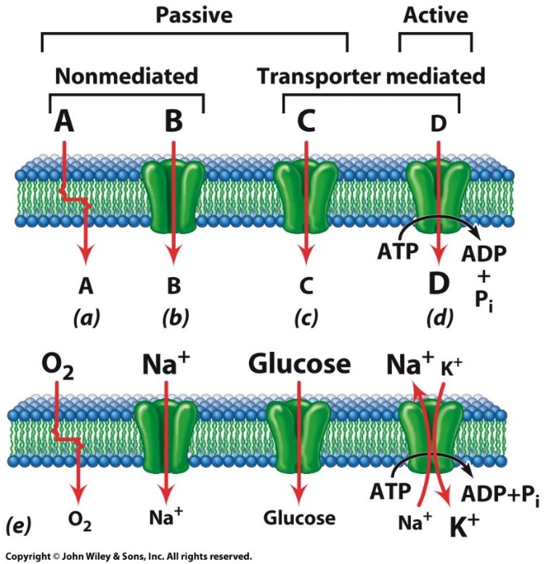
8.9 | Solute Movement Across Cell Membranes
Selective permeability allows for separation and exchange of materials across the plasma membrane
Net flux is the difference between influx and efflux of materials.
Substances move across membranes by:
1) simple diffusion through the lipid bilayer;
2) simple diffusion through an aqueous, protein-lined channel;
3) diffusion facilitated by a protein transporter;
4) active transport, requires an energy-driven protein “pump” to move substances against a concentration gradient
Four basic mechanisms by which solute molecules move across membranes
Notes:
Figure 8.33
Four basic mechanisms by which solute molecules move across membranes. The relative sizes of the letters indicate the directions of the concentration gradients. (A) Simple diffusion through the bilayer, which always proceeds from high to low concentration. (B) Simple diffusion through an aqueous channel formed within an integral membrane protein or a cluster of such proteins. As in A, movement is always down a concentration gradient. (C) Facilitated diffusion in which solute molecules bind specifically to a membrane protein carrier (a facilitative transporter). As in A and B, movement is always from high to low concentration. (D) Active transport by means of a protein transporter with a specific binding site that undergoes a change in affinity driven with energy released by an exergonic process, such as ATP hydrolysis. Movement occurs against a concentration gradient. (E) Examples of each type of mechanism as it occurs in the membrane of an erythrocyte.
1. Passive transport
- energy 사용 x (열역학 법칙에 의해 이동 = concentration-dependent diffusion )
1) simple diffusion
- through the lipid bilayer
- through an aqueous, protein-lined ‘channel’
(concentration-dependent 한 이동에 관여하는 integral protein을 channel 이라고 함)
2) diffusion facilitated by a protein transporter
2. Active transport
- energy 사용 o ( concentration gradient 가 낮은 데서 높은 데로 이동)
- Pump ( = ATPase ) : Energy (ATP) 를 써가면서 gradient 역방향으로 물질을 이동시켜주는 integral protein
ex. Sodium-potassium pump = sodium-potassium ATPase
-

Slide 51
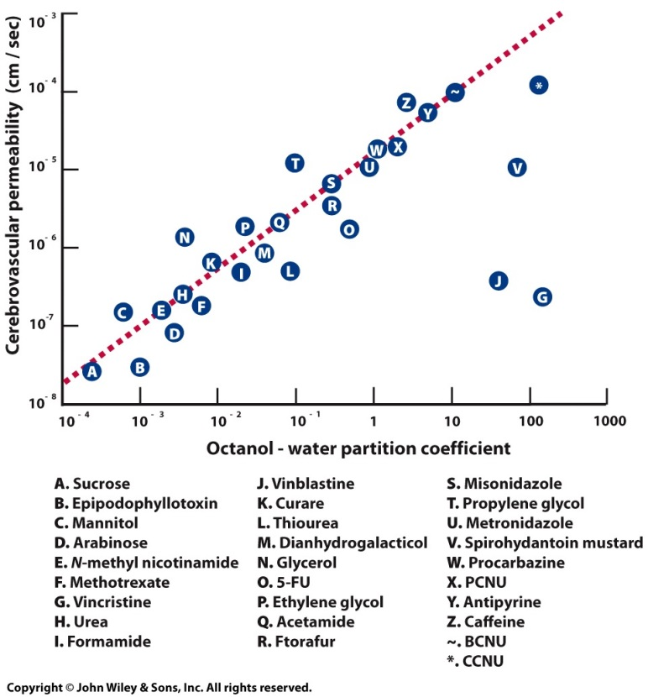
8.10 | Diffusion Through the Lipid Bilayer
Diffusion of Substance Through Membranes
Diffusion requires both a concentration gradient and membrane permeability.
Lipid permeability is determined by the molecular size, polarity, and partition coefficient, the ratio of solubility in a nonpolar solvent to that in water.
Small molecules penetrate the lipid bilayer more rapidly than larger ones.
Polar molecules, like sugars and amino acids, have poor membrane penetration.
The greater the lipid solubility, the faster the penetration.
The relationship between partition coefficient and membrane permeability.
Notes:
Figure 8.34
The relationship between partition coefficient and membrane permeability. In this case, measurements were made of the penetration of a variety of chemicals and drugs across the plasma membranes of the cells that line the capillaries of the brain. Substances penetrate by passage through the lipid bilayer of these cells. The partition coefficient is expressed as the ratio of solubility of a solute in octanol to its solubility in water. Permeability is expressed as penetrance (P) in cm/sec. For all but a few compounds, such as vinblastine and vincristine, penetrance is directly proportional to lipid solubility.
Diffusion 이 얼마나 잘 되는지 factor
Concentration gradient
Membrane permeability ( 더 중요 )
- molecular size
- polarity
- partition coefficient (물 대비 nonpolar solvent 비율)

Slide 52
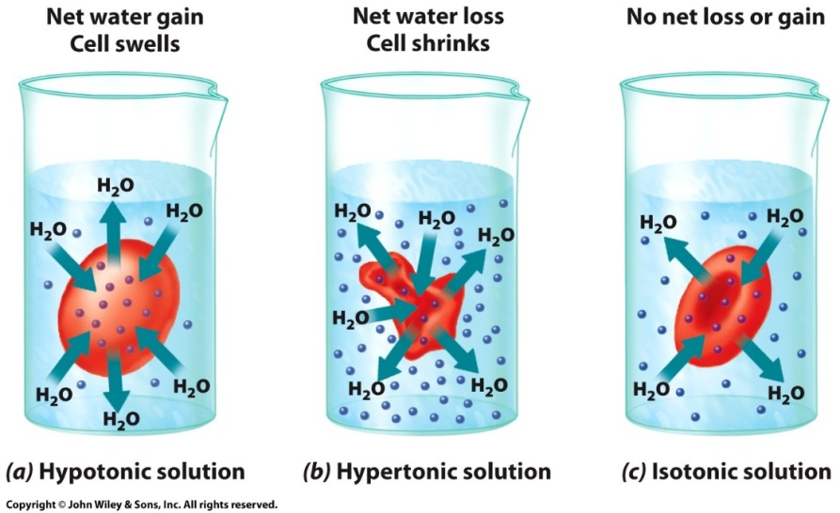
8.10 | Diffusion Through the Lipid Bilayer
The Diffusion of Water Through Membranes
The effects of differences in the concentration of solutes on opposite sides of the plasma membrane
Diffusion of water through a semipermeable membrane is called osmosis.
Water diffuses from areas of lower solute concentration to areas of higher solute concentration.
Cells swell in hypotonic solution, shrink in hypertonic solutions, and remain unchanged in isotonic solutions.
Notes:
Figure 8.35
The effects of differences in the concentration of solutes on opposite sides of the plasma membrane. (A) A cell placed in a hypotonic solution (one having a lower solute concentration than the cell) swells because of a net gain of water by osmosis. (B) A cell in a hypertonic solution shrinks because of a net loss of water by osmosis. (C) A cell placed in an isotonic solution maintains a constant volume because the inward flux of water is equal to the outward flux.
---여기부터 못 들음---
~ 8.13절 active transport 직전 까지 (51~ 63)

Slide 53
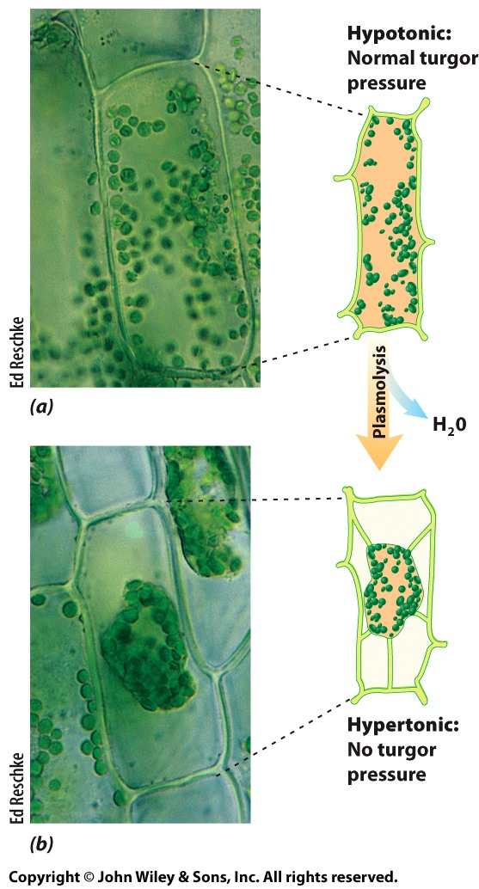
8.10 | Diffusion Through the Lipid Bilayer
The Diffusion of Water Through Membranes
Plants utilize osmosis in different ways as they are usually hypertonic compared to their fluid environment.
There is a tendency for water to enter the cell, causing it to develop an internal (turgor) pressure that pushes against its surrounding wall.
In hypertonic solutions the plant cell undergoes plasmolysis, and the plant loses it support and wilts.
The effects of osmosis on a plant cell
Notes:
Figure 8.36a, b
The effects of osmosis on a plant cell. (A) Aquatic plants living in freshwater are surrounded by a hypotonic environment. Water therefore tends to flow into the cells, creating turgor pressure. (B) If the plant is placed in a hypertonic solution, such as seawater, the cell loses water, and the plasma membrane pulls away from the cell wall.
Plasmolysis = 원형질 분리

Slide 54
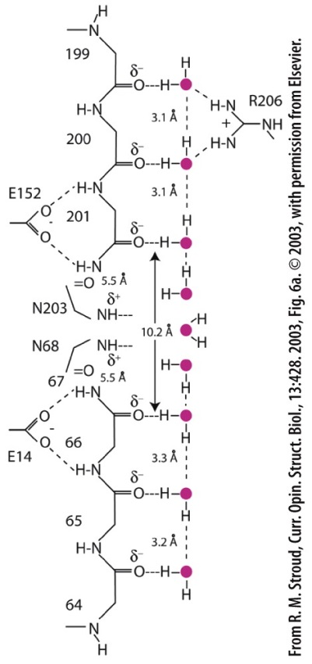
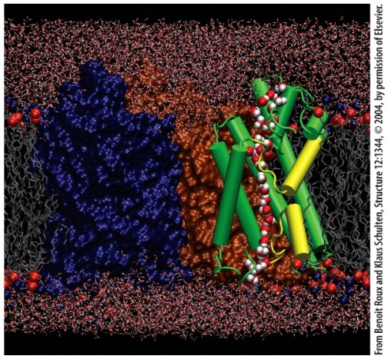
8.10 | Diffusion Through the Lipid Bilayer
The Diffusion of Water Through Membranes
A family of small integral proteins, aquaporins, allow the passive movement of water across the plasma membrane.
It’s central channel is lined primarily by hydrophobic amino acid residues and is highly specific for water molecules.
Water molecules pass in single file while H⁺ ions are not able to penetrate these open pores.
A pair of positive charged residues (N203 and N68) attract the oxygen atom of each water molecule to prevent hydrogen bonds.
Passage of water molecules through an aquaporin channel
Notes:
Figure 8.37a, b
Passage of water molecules through an aquaporin channel. (A) Snapshot from a molecular dynamics simulation of a stream of water molecules (red and white spheres) passing in single file through the channel in one of the subunits of an aquaporin molecule residing within a membrane. (B) A model describing the mechanism by which water molecules pass through an aquaporin channel with the simultaneous exclusion of protons. Nine water molecules are shown to be lined up in single file along the wall of the channel. Each water molecule is depicted as a red circular O atom with two associated Hs. In this model, the four water molecules at the top and bottom of the channel are oriented, as the result of their interaction with the carbonyl (CPO) groups of the protein backbone, with their H atoms pointed away from the center of the channel. These water molecules are able to form hydrogen bonds (dashed lines) with their neighbors. In contrast, the single water molecule in the center of the channel is oriented in a position that prevents it from forming hydrogen bonds with other water molecules, which has the effect of interrupting the flow of protons through the channel.

Slide 55


8.11 | The Diffusion of Ions through Membranes
Ions cross membranes through ion channels.
Ion channels are selective and bidirectional, allowing diffusion in the direction of the electrochemical gradient.
Superfamilies of ion channels have been characterized by patch-clamping experiments.
The voltage across the membrane can be maintained (clamped) at any value, and the current originating in the small patch of membrane surrounded by the pipette can be measured.
Measuring ion conductance by patch-clamp recording
Notes:
Figure 8.38a, b
Measuring ion channel conductance by patch-clamp recording. (A) In this technique, a highly polished glass micropipette is placed against a portion of the outer surface of a cell, and suction is applied to seal the rim of the pipette against the plasma membrane. Because the pipette is wired as an electrode (a microelectrode), a voltage can be applied across the patch of membrane enclosed by the pipette, and the responding flow of ions through the membrane channels can be measured. As indicated in the figure, the micropipette can enclose a patch of membrane containing a single ion channel, which allows investigators to monitor the opening and closing of a single gated channel, as well as its conductance at different applied voltages. (B) The micrograph shows patch-clamp recordings being made from a single photoreceptor cell of the retina of a salamander. One portion of the cell is drawn into a glass micropipette by suction, while a second micropipette-electrode (lower right) is sealed against a small patch of the plasma membrane on another portion of the cell.

Slide 56
8.11 | The Diffusion of Ions through Membranes
Most ion channels can exist in either an open or a closed conformation, and are called gated. The three major categories of gated channels are:
1. Voltage‐gated channels: Conformational state depends on the difference in ionic charge on the two sides of the membrane.
2. Ligand‐gated channels: Conformational state depends on the binding of a specific molecule (ligand), which is usually not the solute that passes through the channel. Ligand-gated channels can either open or close after ligand binding to the outer or inner surface of the channel.
3. Mechano‐gated channels: Conformational state depends on mechanical forces (e.g., stretch tension) that are applied to the membrane. Specific cation channels can be opened by stereocilia movement on the hair cells of the inner ear in response to sound or motions of the head.
Notes:
Voltage-gated channels: 막사이 전위차에 의존해 조절됨 (열리고 닫히고)

Slide 57

8.11 | The Diffusion of Ions through Membranes
The structure and function of voltage-gated potassium ion channels are the best understood.
The KcsA channel consists of four subunits, each subunit has two membrane-spanning helices (M1, M2) and a pore region (P) at the extracellular end of the channel.
The P region forms the lining of a narrow selectivity filter because it allows only the passage of K+ ions with spacing of the backbone carbonyl groups.
Although there are four potential K+ ion binding sites, K+ ions move two at a time.
3D structure of the bacterial KcsA channel and K⁺ ion selectivity
Notes:
Figure 8.39
Three-dimensional structure of the bacterial KcsA channel and the selection of K+ ions. This K+ ion channel consists of four subunits, two of which are shown here. Each subunit is comprised of M1 and M2 helices joined by a P (pore) segment consisting of a short helix and a non-helical portion that lines the channel through which the ions pass. A portion of each P segment contains a conserved pentapeptide (GYGVT) whose res idues line the selectivity filter that screens for K+ ions. The oxygen atoms of the carbonyl groups of these residues project into the channel where they can interact selectively with K+ ions (indicated by the red mesh objects) within the filter. As indicated in the top inset, the selectivity filter contains four rings of carbonyl O atoms and one ring of threonyl O atoms; each of these five rings contains four O atoms, one donated by each subunit. The diameter of the rings is just large enough so that eight O atoms can coordinate a single K ion, replacing its normal water of hydration. Although four K+ binding sites are shown, only two are occupied at one time.

Slide 58
8.11 | The Diffusion of Ions through Membranes
Comparison of the open and closed structures of KcsA strongly suggests that gating is accomplished by conformational changes of the cytoplasmic ends of the inner (M2) helices.
In the closed conformation the M2 helices are straight and cross over one another to form a “helix bundle” that seals the cytoplasmic face of the pore.
The channel opens when the M2 helices bend at a specific hinge point where a glycine residue is located.
Hinge‐bending model for the opening of the KcsA channel
Notes:
Figure 8.40
Schematic illustration of the hinge‐bending model for the opening of the Kcsa channel. The M2 helices from each subunit bend outward at a specific glycine residue, which opens the gate at the intracellular end of the channel to K+ ions.
SOURCE: Uysal S et al. 2011. Mechanism of activation gating in the full-length KcsA K+ channel. Proc. Natl. Acad. Sci. U.S.A. 108, 11896-9.

Slide 59

8.11 | The Diffusion of Ions through Membranes
Plant Kv channels play an important role in salt and water balance and in regulation of cell volume, whereas in animals they are best known for their role in muscle and nerve function.
Contain six membrane-associated helices (S1-S6) grouped into two domains:
Pore domain: (S5, S6, P segment) permits the selective passage of K⁺ ions.
Voltage-sensing domain: (S1-S4) senses the voltage across the plasma membrane.
The structure of a eukaryotic, voltage-gated K⁺ channel
Notes:
Figure 8.41
The structure of one subunit of a eukaryotic, voltage-gated K+ channel. A two-dimensional portrait of a K+ channel subunit showing its six transmembrane helices and a portion of the polypeptide (called the pore helix or P) that dips into the protein to form part of the channel’s wall. The inset shows the sequence of amino acids of the positively charged S4 helix of the Drosophila K+ Shaker ion channel, which serves as a voltage sensor. The positively charged side chains are situated at every third residue along the otherwise hydrophobic helix. This member of the Kv family is called a Shaker channel because flies with certain mutations in the protein shake vigorously when anesthetized with ether. The Shaker channel was the first K+ channel to be identified and cloned in 1987.

Slide 60



8.11 | The Diffusion of Ions through Membranes
Three-dimensional structure of a voltage-gated mammalian K⁺ channel
A single eukaryotic Kv channel consists of four homologous subunits arranged symmetrically around the central ion-conducting pore.
The selectivity filter, and thus the presumed mechanism of K+ ion selection, is virtually identical in the prokaryotic KcsA and eukaryotic Kv proteins.
S4 helix movement after membrane depolarization initiates conformational changes that opens the gate at the cytoplasmic end of the channel.
Notes:
Figure 8.42a-c
Three-dimensional structure of a voltage-gated mammalian K+ channel. (A) The crystal structure of the entire tetrameric Kv1.2 channel, a member of the Shaker family of K+ ion channels found in nerve cells of the brain. The transmembrane portion is shown in red, and the cytoplasmic portion in blue. The potassium ion binding sites are indicated in green. (B) Ribbon drawing of the same channel shown in A, with the four subunits that make up the channel shown in different colors. If you focus on the red subunit, you can see (1) the spatial separation between the voltage-sensing and pore domains of the subunit and (2) the manner in which the voltage-sensing domain from each subunit is present on the outer edge of the pore domain of a neighboring subunit. The cytoplasmic portion of this particular channel consists of a T1 domain, which is part of the channel polypeptide itself, and a separate polypeptide. (C) Ribbon drawing of a single subunit showing the spatial orientation of the six membrane-spanning helices (S1–S6) and also the presence of the S4–S5 linker helix, which connects the voltage-sensing and pore domains. This linker transmits the signal from the S4 voltage sensor that opens the channel. The inner surface of the channel below the pore domain is lined by the S6 helix (roughly similar to the M2 helix of the bacterial channel shown in Figure 8.39). The channel shown here is present in the open configuration with the S6 helices curved outward (compare to Figure 8.40) at the site marked PVP (standing for Pro-Val-Pro, which is likely the amino acid sequence of the “hinge”).

Slide 61


8.11 | The Diffusion of Ions through Membranes
Once opened, more than 10 million K⁺ ions can pass through per second.
After the channel is open for a few milliseconds, the movement of K⁺ ions is “automatically” stopped by a process known as inactivation.
Channel inactivation occurs by movement of a small inactivation peptide that dangles from the cytoplasmic portion of the protein.
Can exist in three different states: open, inactivated, and closed.
Conformational states of a voltage-gated K⁺ ion channel
Notes:
Figure 8.43a, b
Conformational states of a voltage-gated K+ ion channel. (A) Three-dimensional model of a eukaryotic K+ ion channel. Inactivation of channel activity occurs as one of the inactivation peptides, which dangle from the cytoplasmic portion of the complex, fits into the cytoplasmic opening of the channel. (B) Schematic representation of a view into a K+ ion channel, perpendicular to the membrane from the cytoplasmic side, showing the channel in the closed (resting), open, and inactivated state.

Slide 62

8.12 | Facilitated Diffusion
In many cases, the diffusing substance binds selectively to a membrane-spanning protein, called a facilitative transporter.
Solute binding triggers a conformational change to expose it to the other membrane surface and diffuse down its concentration gradient.
Facilitated transporters can mediate the movement of solutes in both directions and depends on the relative concentration of the substance on both sides.
Facilitated diffusion is similar to an enzyme-catalyzed reaction since it is specific for the molecules transported.
Schematic model of facilitated diffusion
Notes:
Figure 8.44
Facilitated diffusion. A schematic model for the facilitated diffusion of glucose depicts the alternating conformation of a carrier that exposes the glucose binding site to either the inside or outside of the membrane.

Slide 63

8.12 | Facilitated Diffusion
Transporters can be regulated and exhibit saturation-type kinetics; they can only move hundreds to thousands of molecules per second across the membrane.
It is important in transporting polar solutes, like sugars and amino acids, that do not penetrate the lipid bilayer.
The glucose transporter (GLUT) is an example of facilitated diffusion.
Kinetics of facilitated diffusion compared to simple diffusion
Notes:
Figure 8.45
The kinetics of facilitated diffusion as compared to that of simple physical diffusion.

Slide 64
8.12 | Facilitated Diffusion
Insulin plays a key role in maintaining proper blood sugar levels.
An increase in blood glucose levels triggers the secretion of insulin, which stimulates the uptake of glucose.
When insulin levels are low, responsive cells contain relatively few glucose transporters, GLUT4, on their plasma membrane.
Rising insulin levels stimulates the movement of transporters to the cell surface where they can bring glucose into the cell.
Kinetics of facilitated diffusion compared to simple diffusion
Notes:
Figure 8.45
The kinetics of facilitated diffusion as compared to that of simple physical diffusion.

Slide 65
8.13 | Active Transport
Cells maintain an imbalance of ions across the plasma membrane, which cannot occur by either simple or facilitated diffusion.
Gradients are generated by active transport, which depends on integral membrane protein “pumps” to bind a solute and move it across the membrane in a process driven by changes in the protein’s conformation.
Coupled energy input is needed like ATP hydrolysis, absorbance of light, electron transport, or the flow of other substances down their gradients.
Notes:
Calcium Sodium 은 세포 안보다 세포 밖의 농도가 더 높다.
Potassium 은 세포 밖이 높음
세포 경계로 농도 차이를 유지하는데 기여하는 protein 은 sodium-potassium pump (ATPase)
polarization 분극 depolarization 탈분극 (+ charge 증가하는 거) hyperpolarization 과분극
Hypopolarization 저분극 → a change in the membrane potential that makes the membrane less negative inside (세포 내부 – charge 가 줄어드는 현상)
신경세포 내부는 자극 받기 전 (-) charge 유지하다가 자극 받으면 Na+ 가 들어와 점점 (+) charge 띠게 됨 ( = depolarization : 탈분극)
+ voltage gated channel 열려서

Slide 66


Slide 67

8.13 | Active Transport
Primary Active Transport: Coupling Transport to ATP Hydrolysis
The Na⁺/K⁺ ATPase (sodium-potassium pump)requires K⁺ outside, Na⁺ inside, and is inhibited by ouabain.
The ratio of Na⁺:K⁺ pumped is 3:2.
The ATPase is a P-type pump, in which phosphorylation causes changes in conformation and ion affinity that allow transport against gradients.
Notes:
Figure 8.46a, b
The Na+/K+-ATPase. (A) Simplified schematic model of the transport cycle. Sodium ions (1) bind to the protein on the inside of the membrane. ATP is hydrolyzed, and the phosphate is transferred to the protein (2), changing its conformation (3) and allowing sodium ions to be expelled to the external space. Potassium ions then bind to the protein (4), and the phosphate group is subsequently lost (5), which causes the protein to snap back to its original conformation, allowing the potassium ions to diffuse into the cell (6). The cation binding sites are located deep within the transmembrane domain, which consists of 10 membrane-spanning helices. Note that the actual Na+/K+-ATPase is composed of at least two different membrane-spanning subunits: a larger alpha subunit, which carries out the transport activity, and a smaller beta subunit, which functions primarily in the maturation and assembly of the pump within the membrane. A third (gamma) subunit may also be present. (Steps where ATP binds to the protein prior to hydrolysis are not included.) (B) A model of the E2 conformation of the protein based on a recent X-ray crystallographic study. The two rubidium ions are located where the potassium ions would normally be bound.
시험 출제 가능성 높음
세포 밖 calcium 농도는 mM level 로 존재 / 세포 안 calcium 농도는 μM 로 존재 (calcium pump 가 있는 거지)
그러다가 자극이 와서 calcium channel 이 열리면 calcium 이 내부로 확산되겠지
평상시보다 ca 농도가 높아지면 세포 내부의 calcium binding protein 들과 결합 시작 (ex. Calmodulin (= CaM) : Ca 2+ ion 이 붙으면 conformation change 가 아주 심하게 일어난다.)
이 변화된 구조가 다른 여러 protein 과 결합
근데 농도가 너무 높아지면 세포 사멸 → 0.1μM ~ 10μM ? 정도 사이만 왔다 갔다 함 (이걸 조절해 주는 애가 calcium pump 랑 endoplasmic reticulum / mitochondria / intracellular organelle ) ➔ 엄청 중요한거지
ER 에도 calcium pump 가 있음 → 그 안쪽에 Ca2+ 있음 (cytoplasm calcium 농도보다 높음) → 어떤 신호를 받으면 calcium 이 ER에서 cytoplasm 이동 ( ER에도 calcium channel 있으니)
Mitochondria, intracellular organelle 도 Ca2+ storage 역할을 해줌 (얘네도 calcium pump 랑 calcium channel 이 있으니까)
Calcium concentration 조절이 안되어 세포가 사멸하면서 생기는 질환 多

Slide 68

8.13 | Active Transport
Primary Active Transport: Coupling Transport to ATP Hydrolysis
E1 conformation: Ion binding sites are accessible to the inside of the cell.
E2 conformation: Ion binding sites are accessible to the outside of the cell.
The change in protein structure between the conformations alternately exposes ion binding sites to the opposite membrane.
The sodium–potassium pump is found only in animal cells.
The Na⁺/K⁺-ATPase pump:
A model of the E2 conformation
Notes:
Figure 8.46a, b
The Na+/K+-ATPase. (A) Simplified schematic model of the transport cycle. Sodium ions (1) bind to the protein on the inside of the membrane. ATP is hydrolyzed, and the phosphate is transferred to the protein (2), changing its conformation (3) and allowing sodium ions to be expelled to the external space. Potassium ions then bind to the protein (4), and the phosphate group is subsequently lost (5), which causes the protein to snap back to its original conformation, allowing the potassium ions to diffuse into the cell (6). The cation binding sites are located deep within the transmembrane domain, which consists of 10 membrane-spanning helices. Note that the actual Na+/K+-ATPase is composed of at least two different membrane-spanning subunits: a larger alpha subunit, which carries out the transport activity, and a smaller beta subunit, which functions primarily in the maturation and assembly of the pump within the membrane. A third (gamma) subunit may also be present. (Steps where ATP binds to the protein prior to hydrolysis are not included.) (B) A model of the E2 conformation of the protein based on a recent X-ray crystallographic study. The two rubidium ions are located where the potassium ions would normally be bound.

Slide 69
Copyright 2017 John Wiley & Sons, Inc.
All rights reserved. Reproduction or translation of this work beyond that permitted in section 117 of the 1976 United States Copyright Act without express permission of the copyright owner is unlawful. Request for further information should be addressed to the Permissions Department, John Wiley & Sons, Inc. The purchaser may make back-up copies for his/her own use only and not for distribution or resale. The Publisher assumes no responsibility for errors, omissions, or damages caused by the use of these programs or from the use of the information herein.

